Slide 1


Slide 2
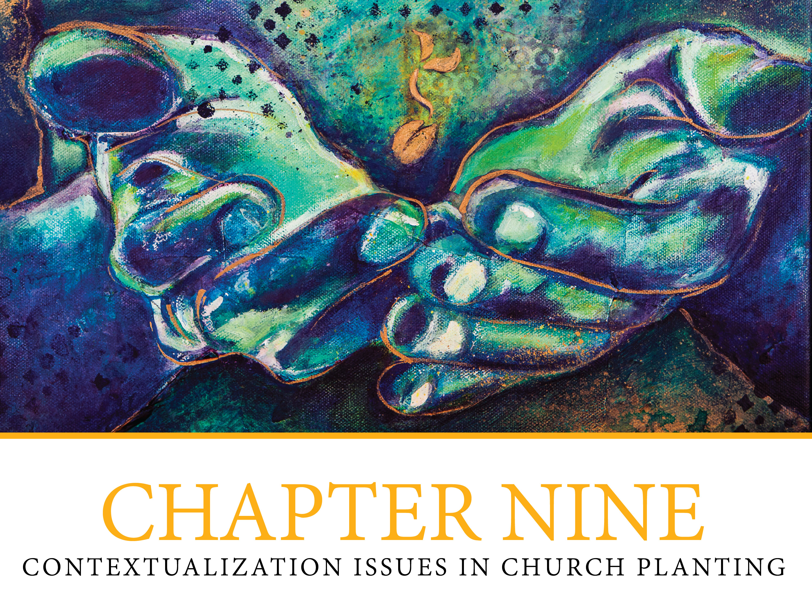

Slide 3

Contextualization Issues
Critical contextualization
  What is contextualization?
  Contextualizing the gospel message
  What is involved?
  How can I best communicate the message?
  What should I avoid?

Slide 4
Critical Contextualization, continued
Contextualizing the Messenger
  Evaluate practices, actions behaviors help or hinder?
  Removing cultural barriers
  What must the messenger give up?
Contextualizing the Church
  What is involved?
  What should be avoided?

Slide 5

Cross-cultural Issues
  Cross-cultural ministry can occur within one’s own country
  Don Richardson’s experience
  “Context matters!”

Slide 6
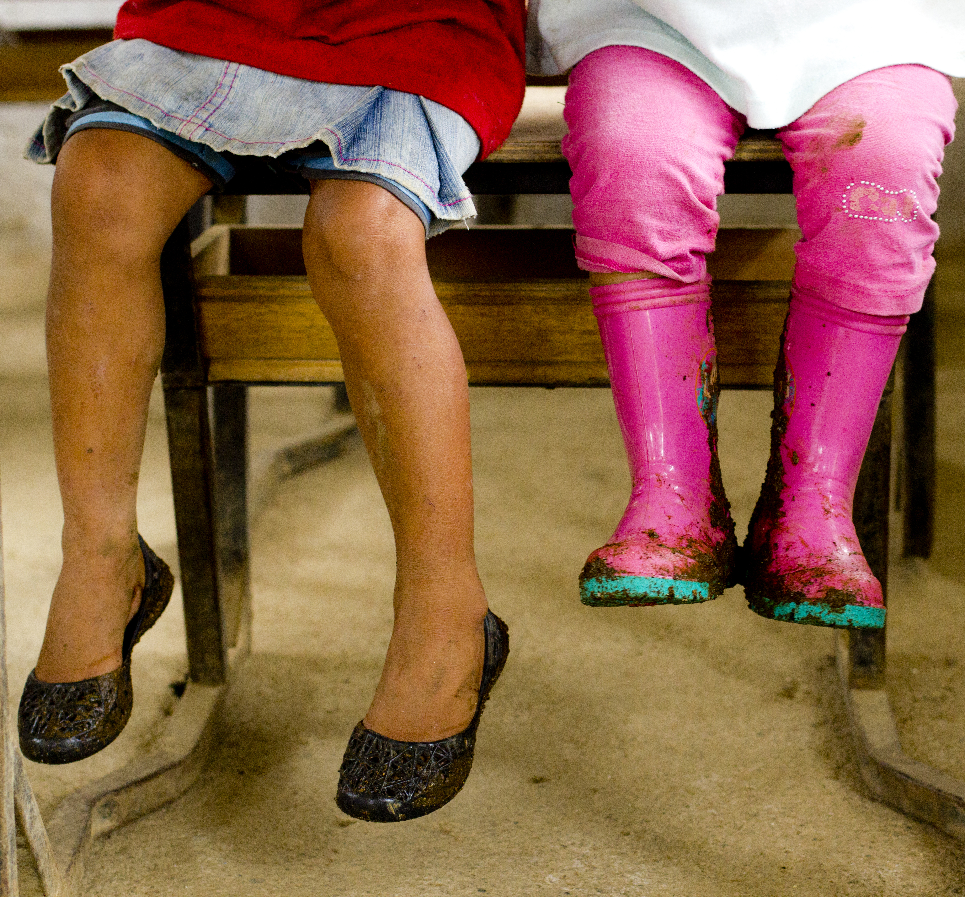
Cross-cultural Issues, continued
Hot- and Cold-Climate Cultures
  Relationship vs. Task orientation
  Direct vs. Indirect communication
  Individualism vs. Group orientation
  Inclusion vs. Privacy
  Views on hospitality
  Views on time and planning

Slide 7
Cross-cultural Issues, continued
High context vs. low context cultures
Individualistic vs. collectivistic cultures
Guilt-based, shame-based, fear-based cultures
  Guilt/righteousness
  Honor/shame
  Fear/power

Slide 8
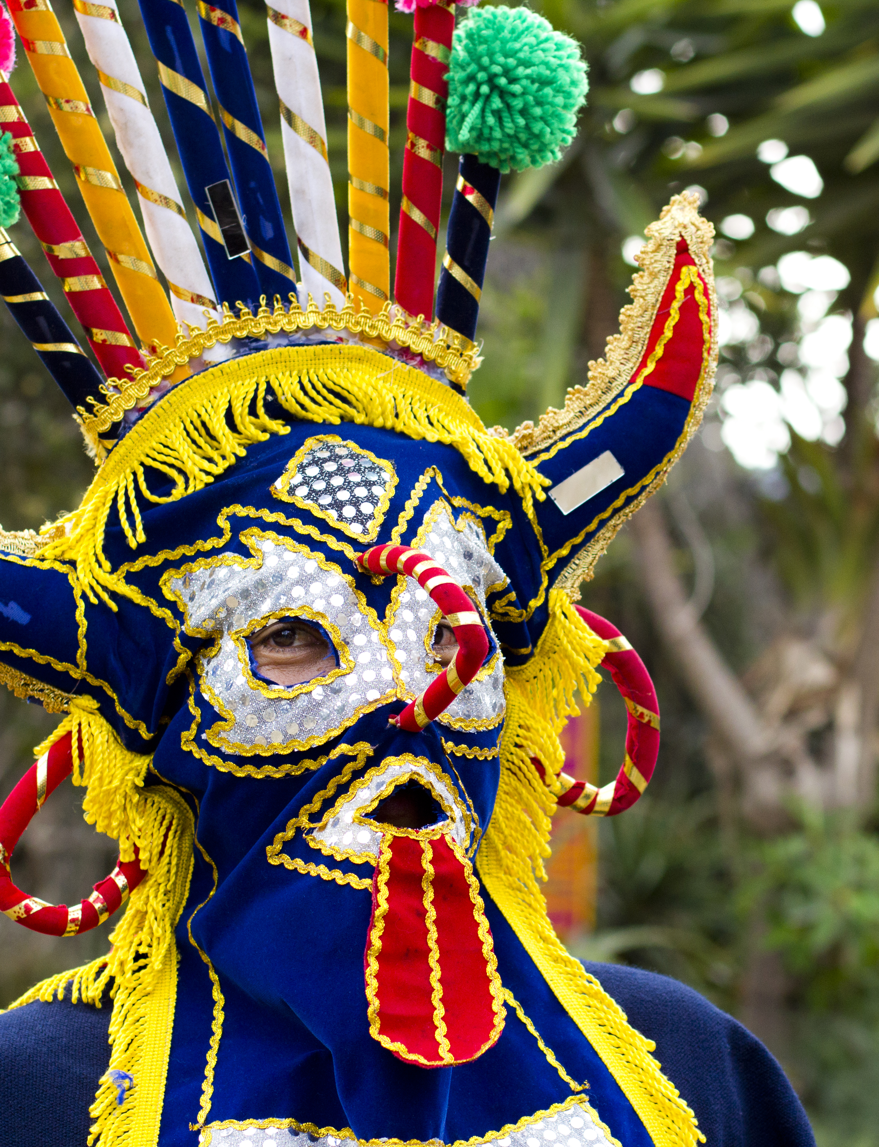
Church/Context
  Society
  Culture
  Worldview
  Contextualization
  Incarnational Church Planting

