Slide 1


Slide 2


Slide 3

Five Functions of a Healthy Church
“Those who accepted his message were baptized, and about three thousand were added to their number that day. They devoted themselves to the apostles’ teaching and to the fellowship, to the breaking of bread and to prayer. Everyone was filled with awe, and many wonders and miraculous signs were done by the apostles. All the believers were together and had everything in common. Selling their possessions and goods, they gave to anyone as he had need. Every day they continued to meet together in the temple courts. They broke bread in their homes and ate together with glad and sincere hearts, praising God and enjoying the favor of all the people. And the Lord added to their number daily those who were being saved.”
Acts 2:41-47

Slide 4
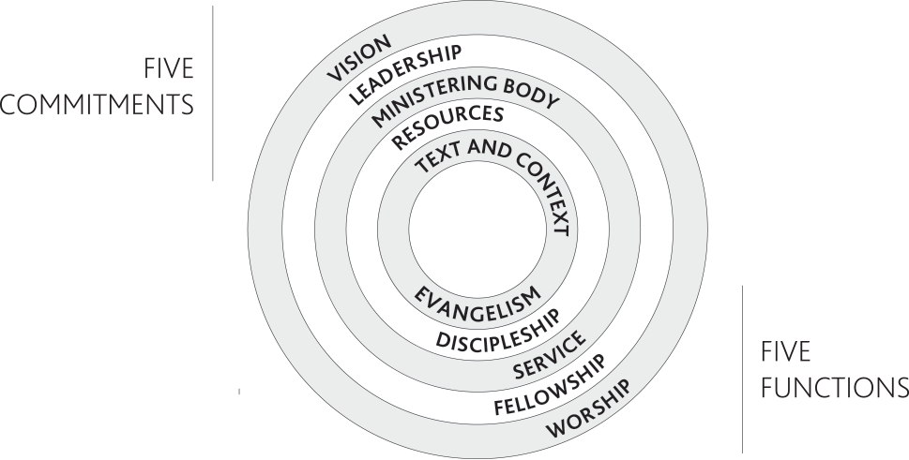

Slide 5
Compelling Witness
Know the people you hope to reach
Identify a niche group
Identify stumbling blocks
Decide how the whole church can participate
Tell our story and God’s story
“The Big Story”

Slide 6
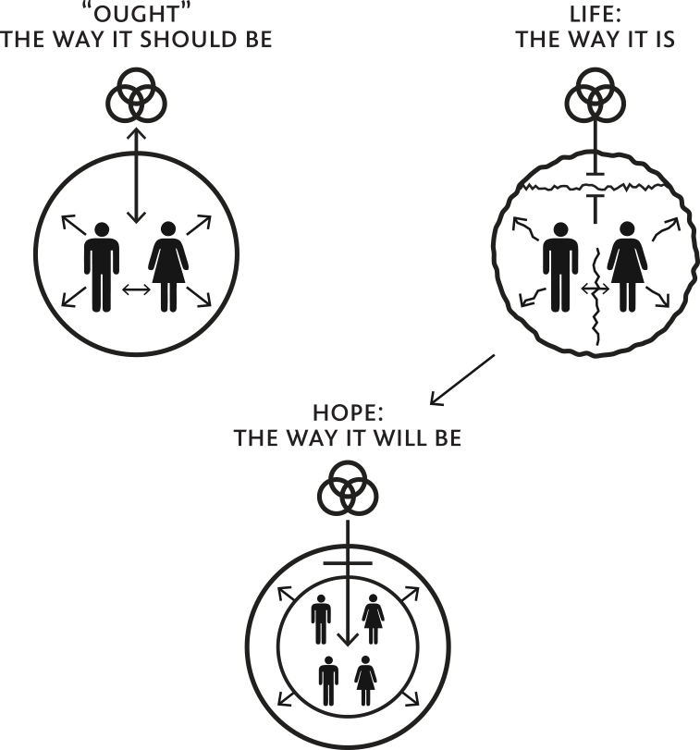

Slide 7
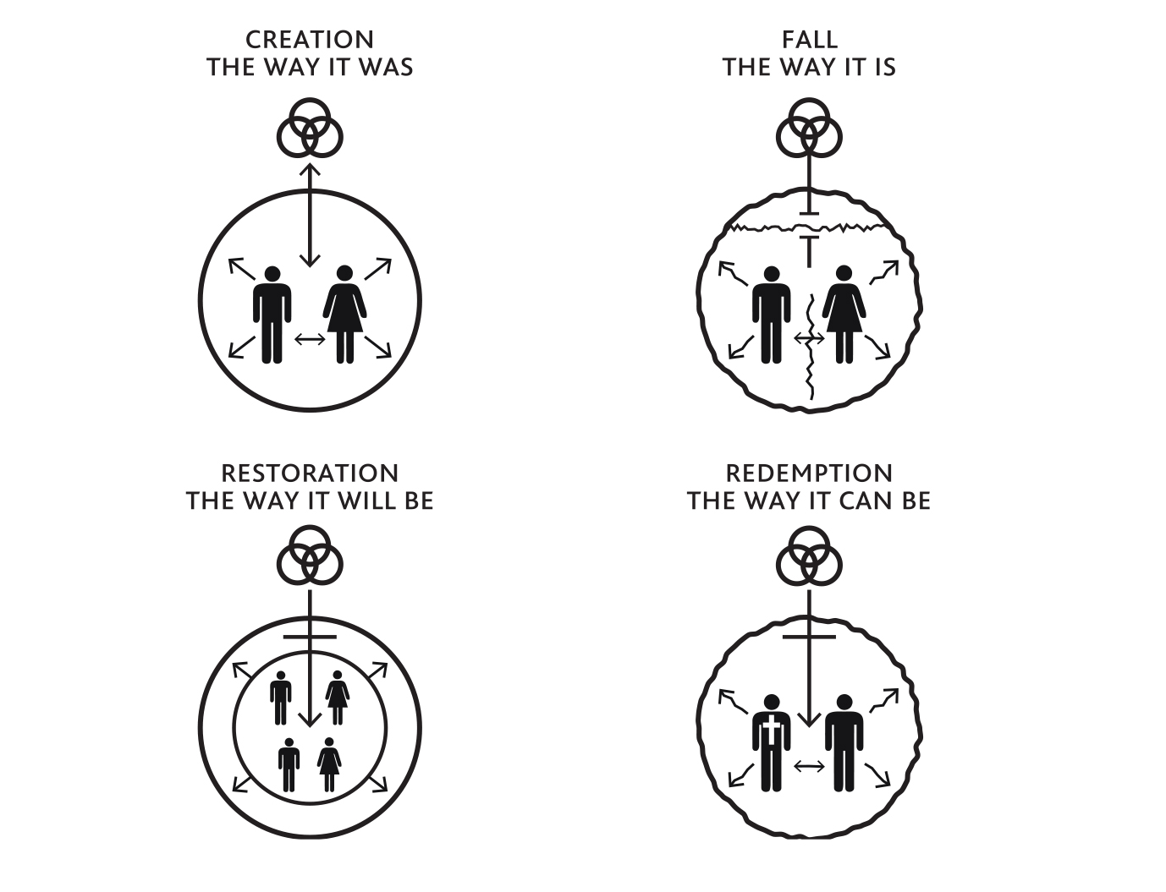

Slide 8
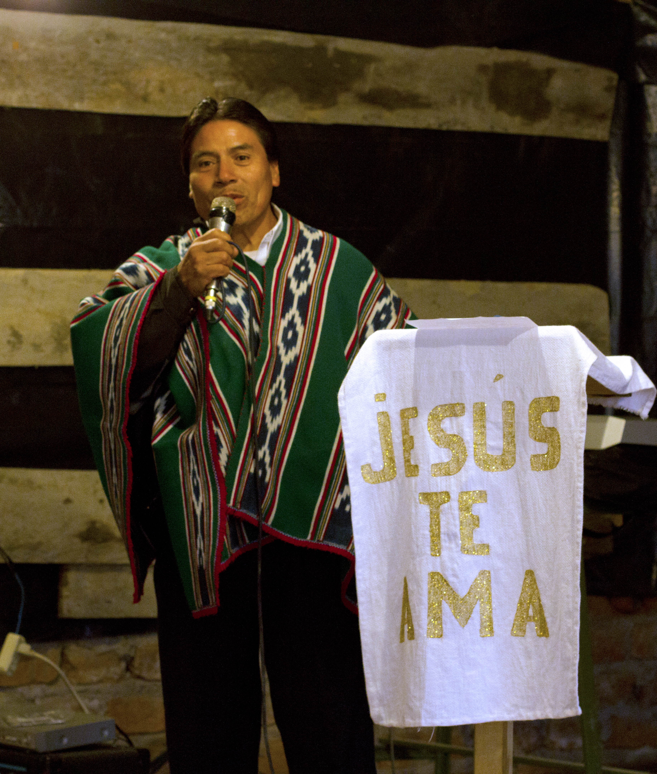
Compelling Witness, continued
Helping others tell the Story
Pursue a total encounter with Jesus
Power Encounter
Truth Encounter
Commitment Encounter

Slide 9
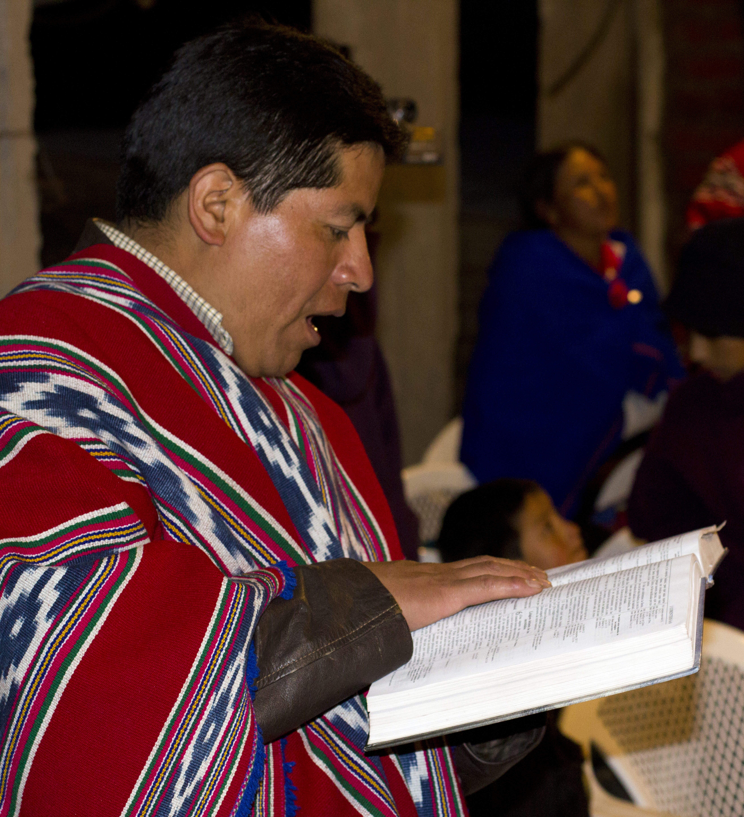
Comprehensive Discipleship
“They devoted themselves to the apostles’ teaching.”
(Acts 2:42)

Slide 10
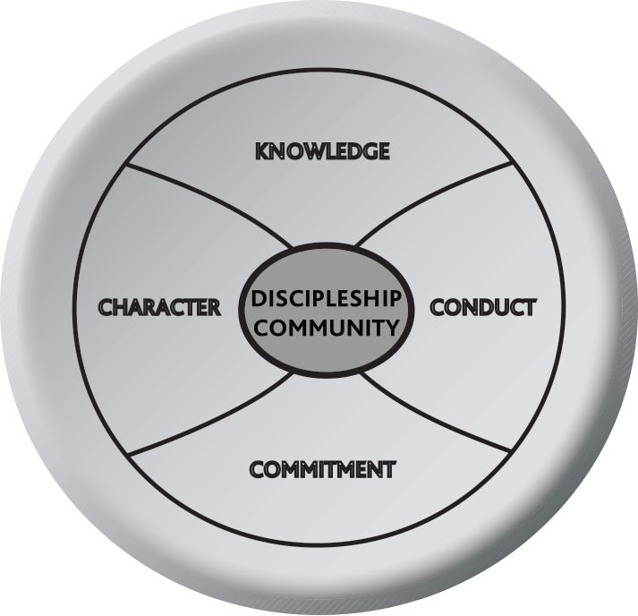
Comprehensive Discipleship, continued
A person who learns

Slide 11
Comprehensive Discipleship, continued
Knowledge: Knowing
Conduct: Doing
Character: Being
Commitment: Willing
  “A profound transformation”

Slide 12
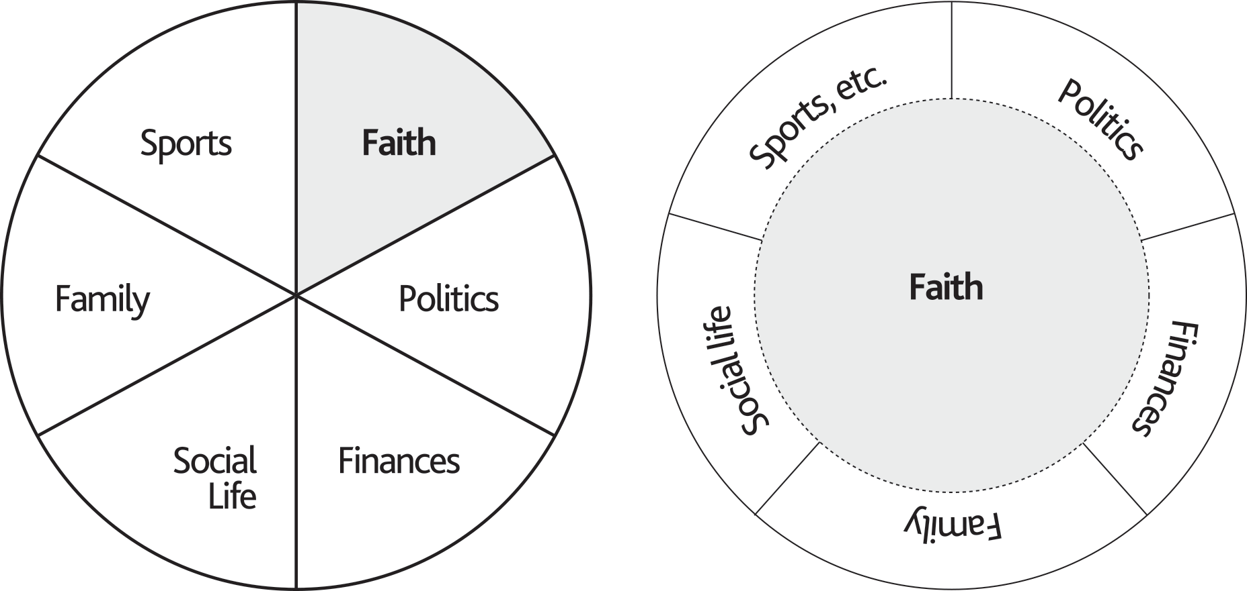
A Segmented View vs. An Integrated View of Faith and Life

Slide 13
