Slide 1


Slide 2


Slide 3

Five Commitments of a Healthy Church
“God’s intent was that now, through the church, the manifold wisdom of God should be made known to the rulers and authorities in the heavenly realms, according to his eternal purpose which he accomplished in Christ Jesus our Lord.” (Ephesians 3:10-11)

Slide 4
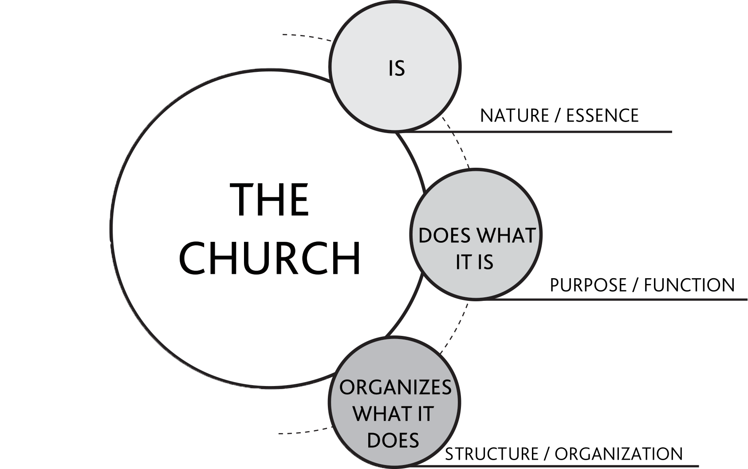
The Redemptive Reign of God through the Church in Mission

Slide 5
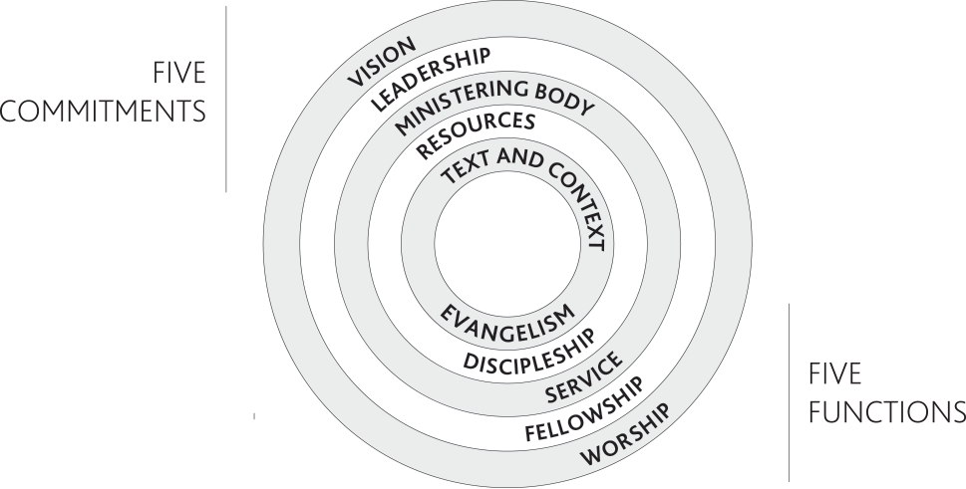

Slide 6
Biblical Cases for the Commitments and Functions
FIVE COMMITMENTS | FIVE FUNCTIONS
CLEAR AND INSPIRING VISION Mtt. 9:36-38; Luke 4:14-21 Acts 1:8 2 Cor. 5:14-21; 2 Tim. 2:15, 22- 24; 2 Tim. 4:1-7 | COMPELLING WITNESS Matt. 28:18-20; Luke 24:45-48 Acts 5:42; Acts 10:34-43 Rom. 10:13-15; 2 Cor. 4:5; 2 Cor. 5:20-21
MOBILIZING LEADERSHIP Mark 10:42-45; John 13:1-17 Acts 6:1-7; Acts 13:1-3; Acts 20:28-31a 2 Cor. 2:17; 2 Cor. 4:1-2; Eph. 4:11-13 | COMPREHENSIVE DISCIPLESHIP Matt. 28:18-20 Acts 17:11; Acts 19:9b-10 2 Tim. 2:2; Titus 2:7-8; 2 Pet. 3:18
MOTIVATED MINISTERING BODY Luke 10:1-2 Acts 6:1-7 Rom. 12:4, 6-8; Eph. 4:11-13; 1 Pet. 4:10-11 | COMPASSIONATE SERVICE Matt. 6:1-4; Matt. 20:25-28; Matt. 25:31-46 Acts 6:1-7; Acts 20:35 Gal. 6:10; Heb. 13:16; James 1:22, 27; James 2:14-17
PROPER STEWARDSHIP OF RESOURCES Luke 19:11-26 Acts 2:44-46; Acts 4:32-35 1 Cor. 4:2; 2 Cor. 8:1-7 | CARING AND WELCOMING COMMUNITY John 17:20-23 Acts 2:42, 44 1 Cor. 12:25b-26; Gal. 6:1-2; Eph. 4:32; Heb 10:24-25; 1 John 1:7
INTEGRATION OF TEXT AND CONTEXT John 1:14 Acts 17:18-28 1 Cor. 9:19-23 | DYNAMIC WORSHIP AND PRAYER Matt. 28:8-9; Luke 24:50-52; John 4:19-26 Acts 13:2 Heb. 12:28-29; Rev. 5:9-14

Slide 7
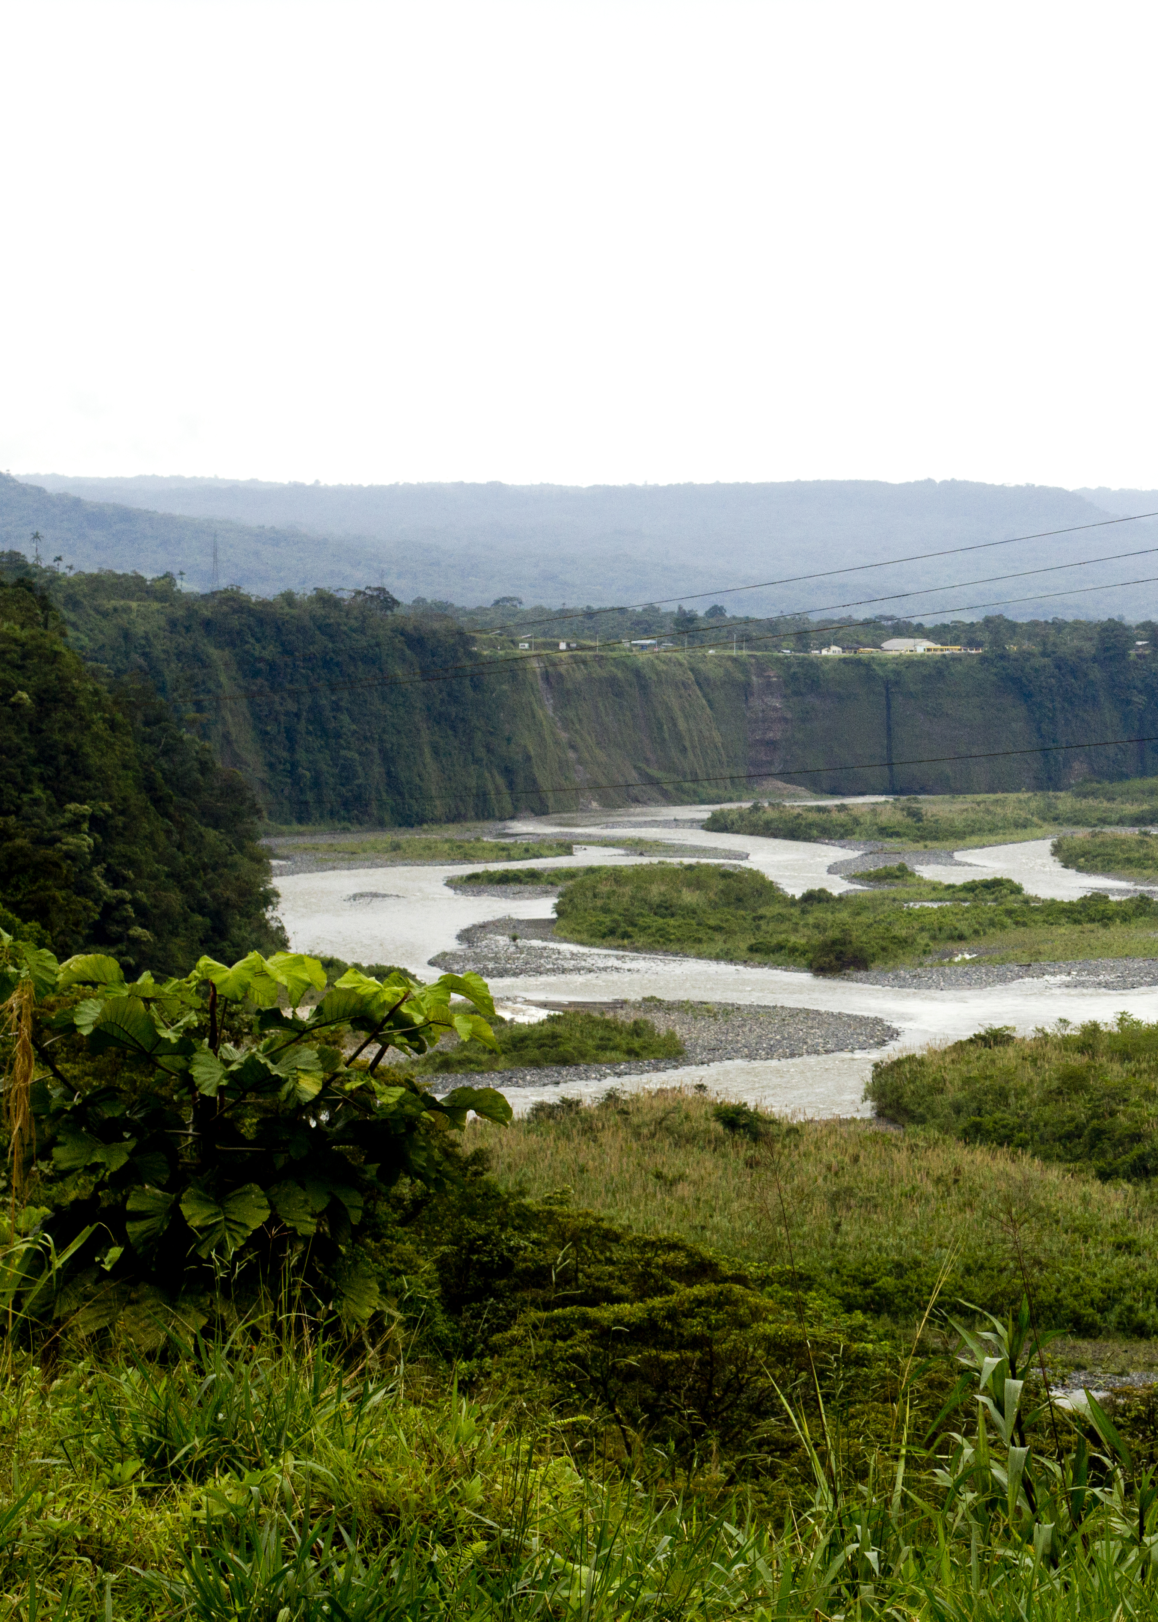
A Clear and Inspiring Vision
A mental picture of a preferred future
God’s vision
Must be held by the group

Slide 8
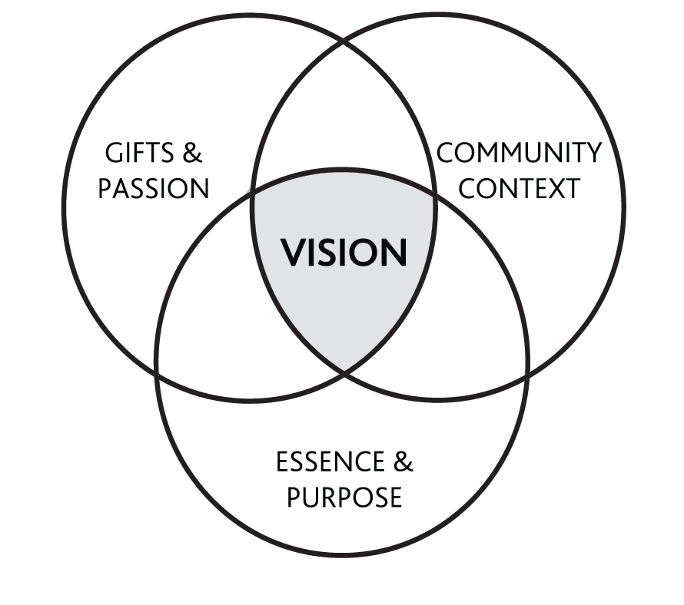
Three Key Ingredients in Clarifying the Vision

Slide 9
Eight Key Elements of a Vision
It projects a clear framework of an ideal future.
It focuses on the future through God’s eyes and provides direction.
It is based on the redemptive purposes of God.
It does not conform to the status quo.
It requires faith. It is ambitious, yet realistic.
It communicates clearly to others.
It motivates people to act. It provides a sense of urgency.
It is a shared vision.

Slide 10
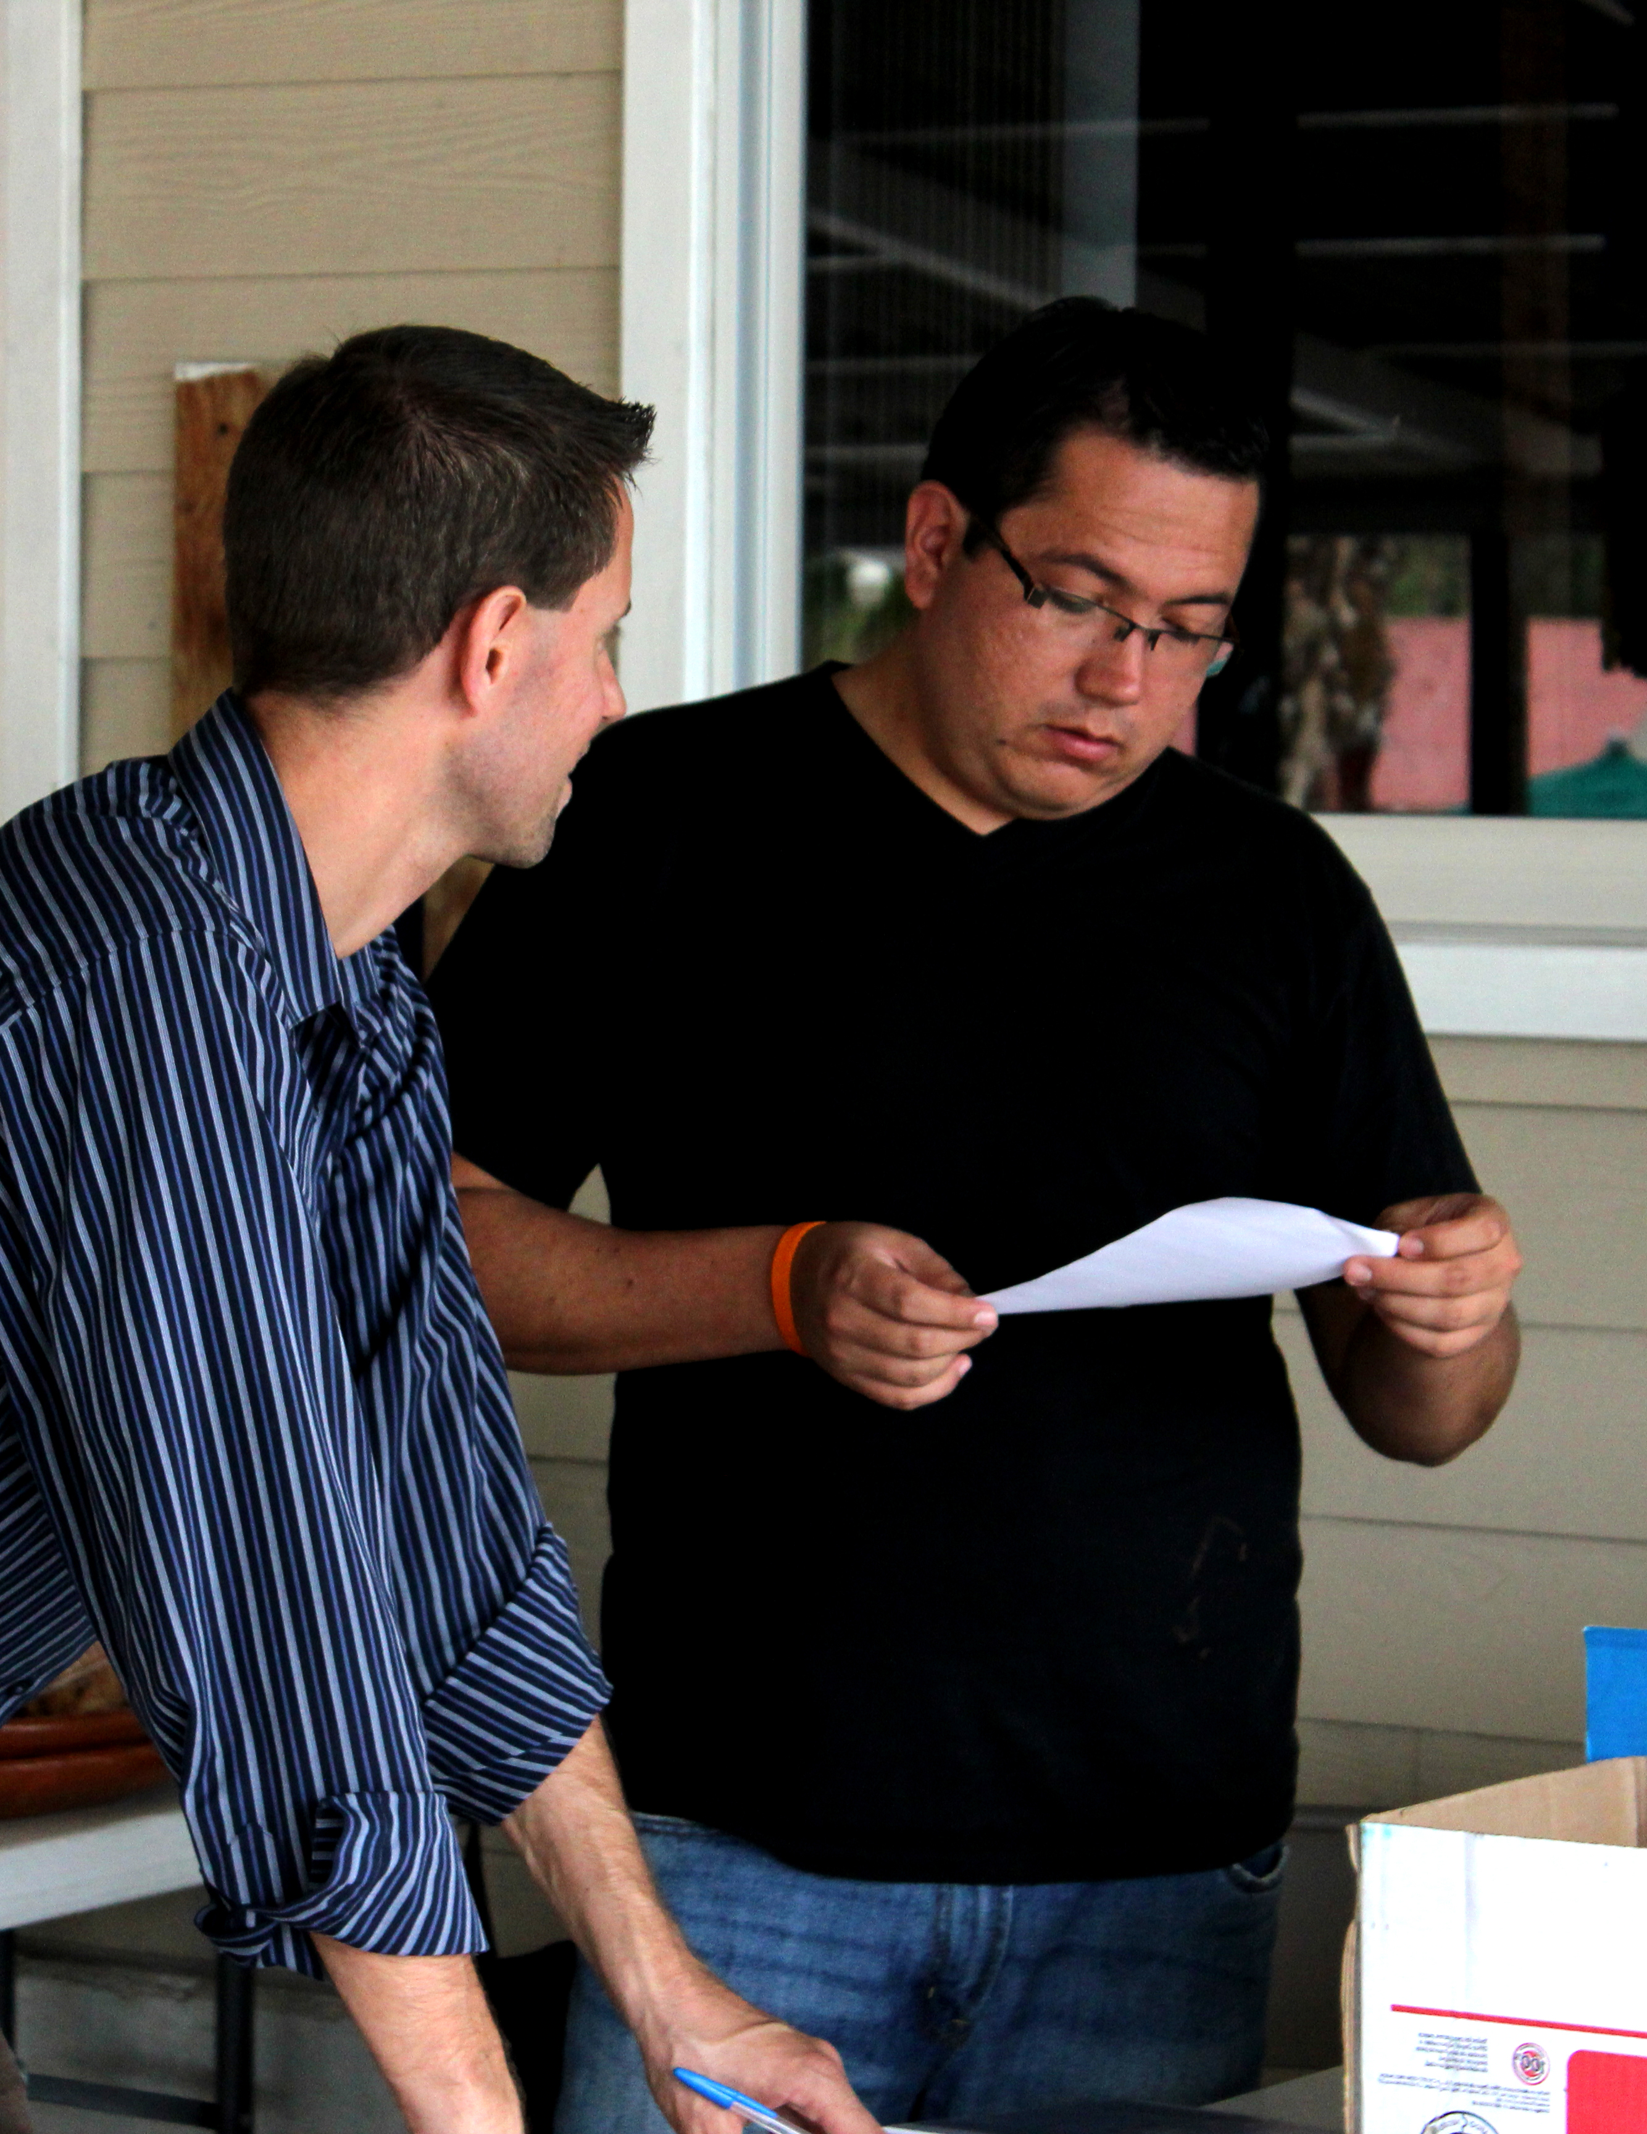
Vision: Steps
Step #1 Define the vision
Step #2 Share the vision
  With clarity and conviction
  Create an environment for others
  Foster a team held together by the vision
  Allow for experimentation and failure
  Keep the vision in everyone’s sight
  Develop a concrete plan around the vision

Slide 11
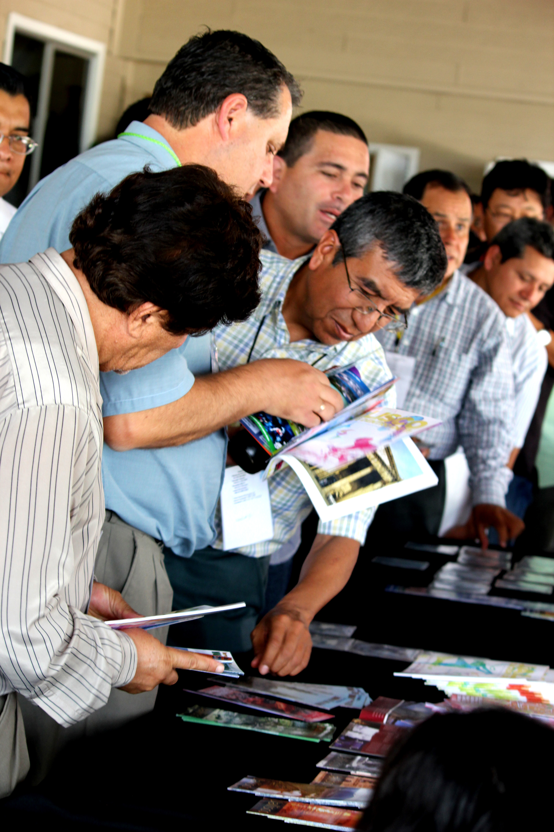
Mobilizing Leadership
Biblical characteristics
Missional characteristics
  Engaging the world
  Motivating and involving the members
  Seeding mission

Slide 12
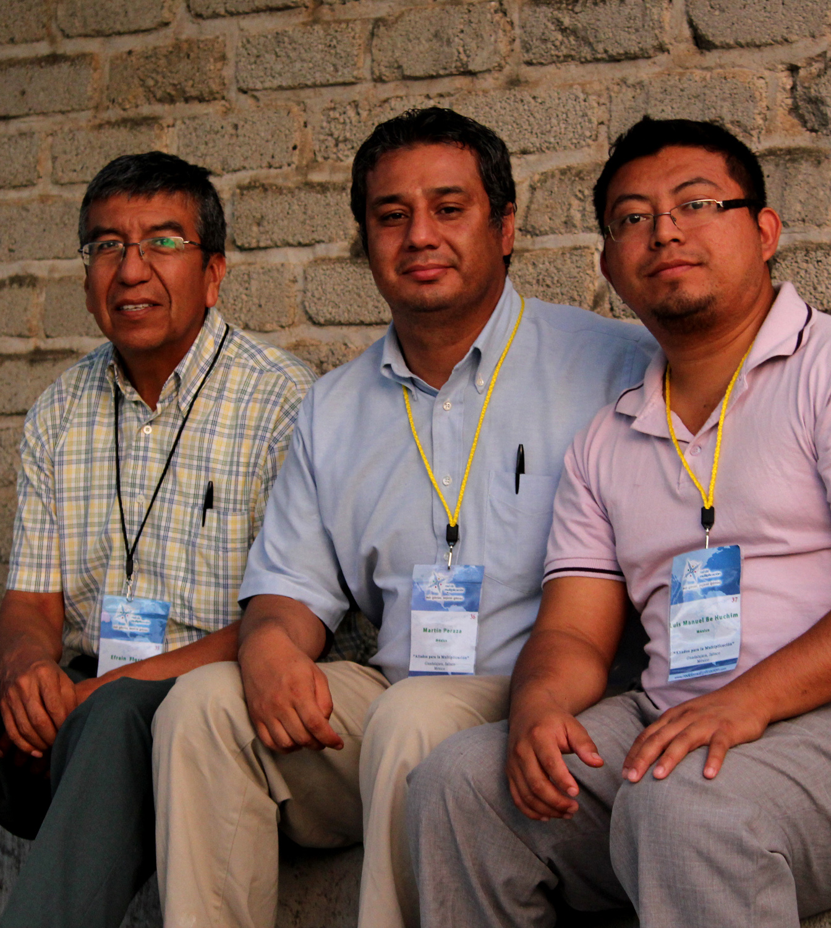
Mobilizing Leadership, continued
Differentiating Characteristics
  Catalyzer
  Organizer
  Operator
  Revitalizer

Slide 13
Motivated Ministry Body
2 Timothy 2:2 “And the things you have heard me say in the presence of many witnesses entrust to reliable people who will also be qualified to teach others.”
(Discipleship)
  Priesthood of all believers
  Gift-based ministry

Slide 14
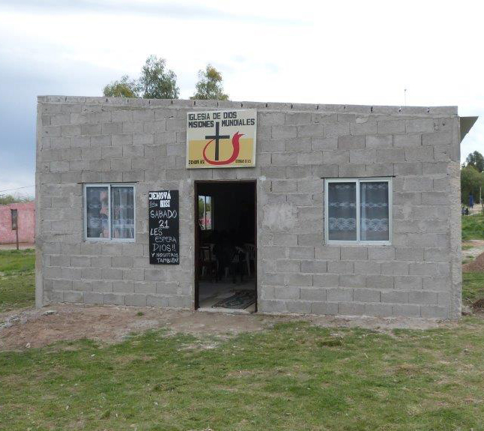
Proper Stewardship of Resources
Time
Talents
Treasure
  Location
  Finances

Slide 15
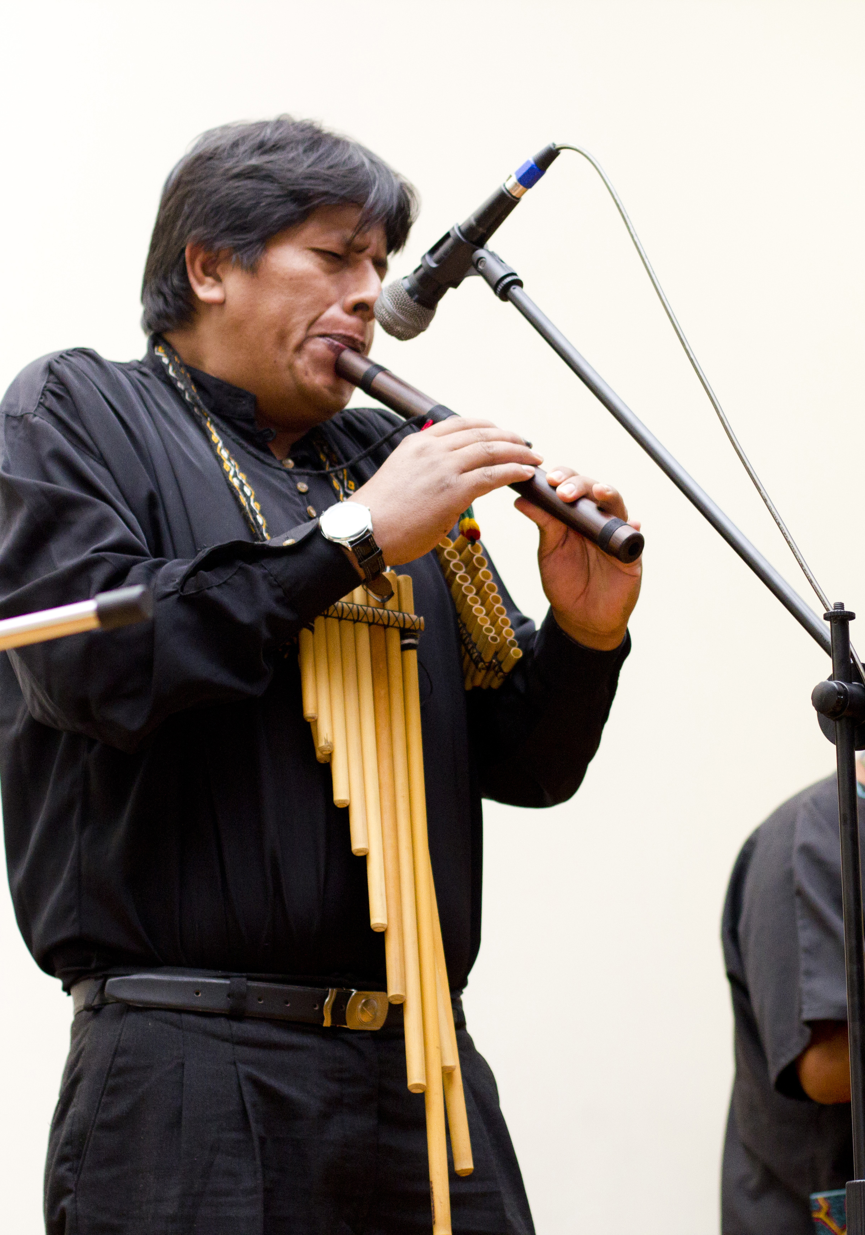
Text and Context
Centrality of the text
  Psalm 19:105
  2 Timothy 3:16-17
  Colossians 3:16
Know your context
Enter a culture
Challenge a culture
Appeal to the listeners

Slide 16
