Slide 1


Slide 2


Slide 3

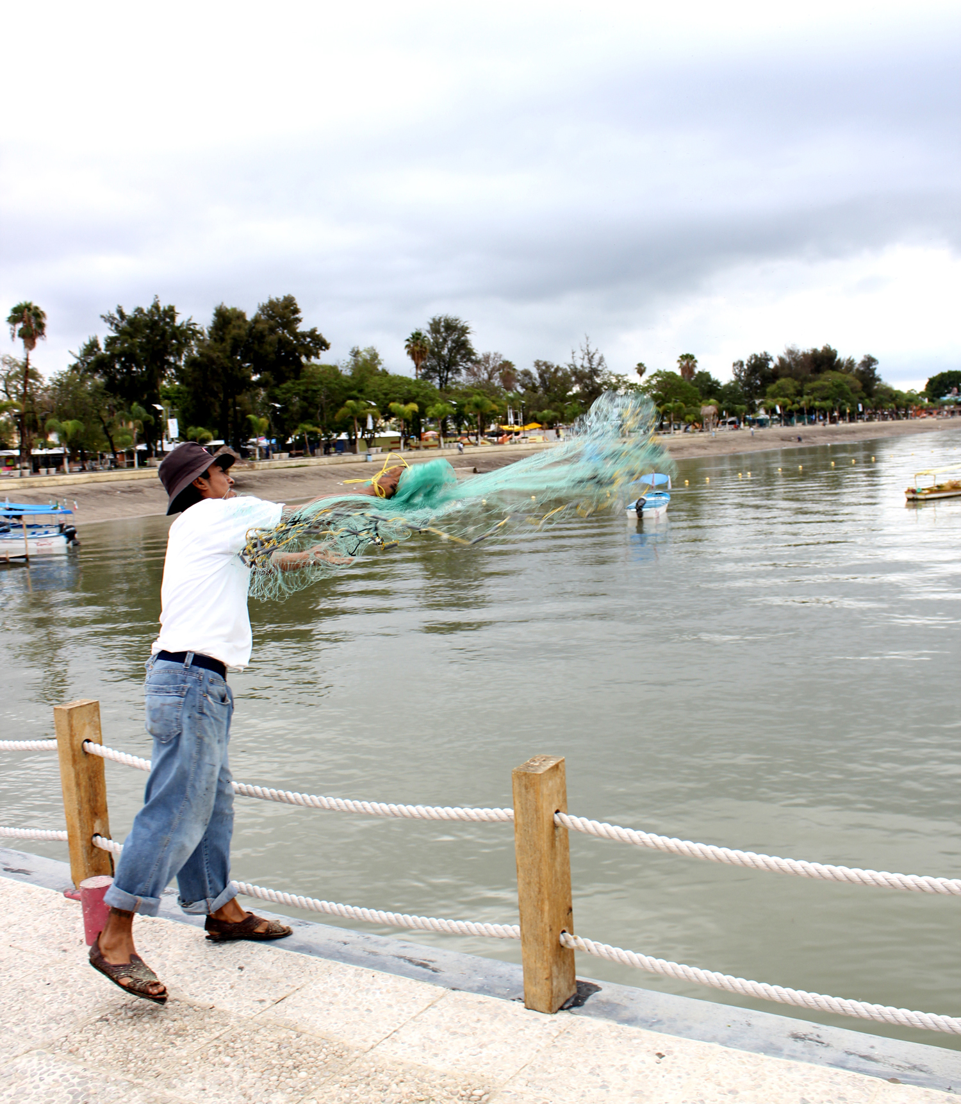
Who Should Plant Churches?
Charles Ridley
13 Characteristics
  Indispensable
  Non-negotiable
  Essential

Slide 4
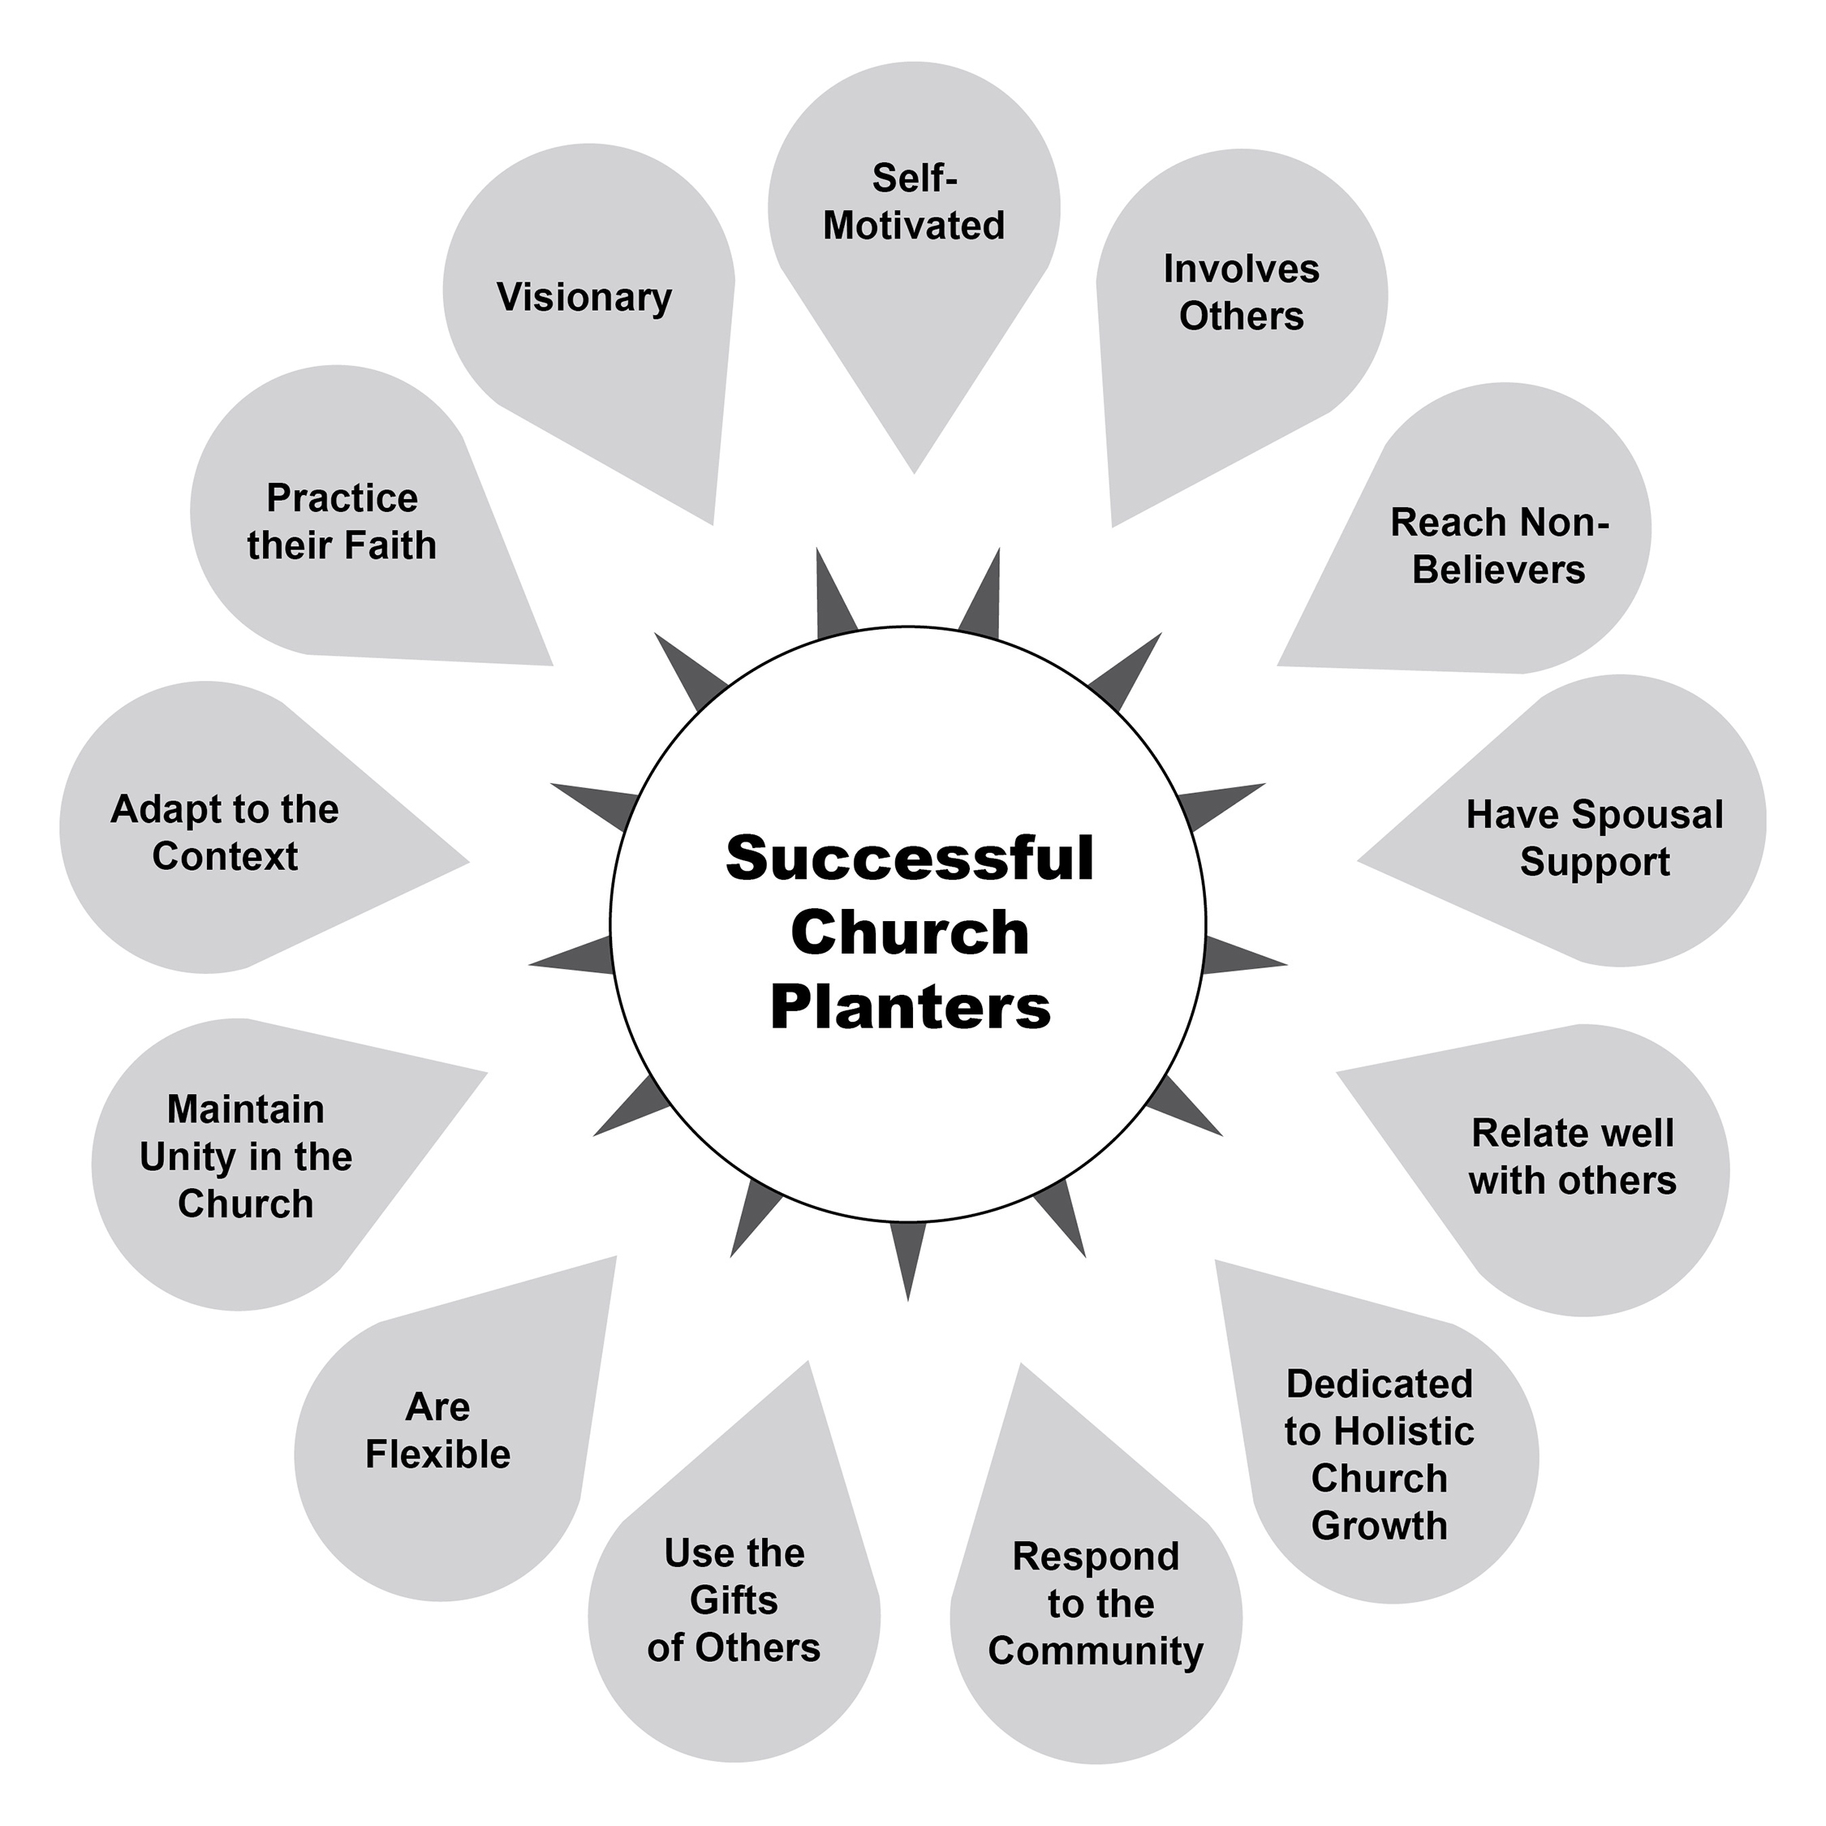
13 Characteristics

Slide 5
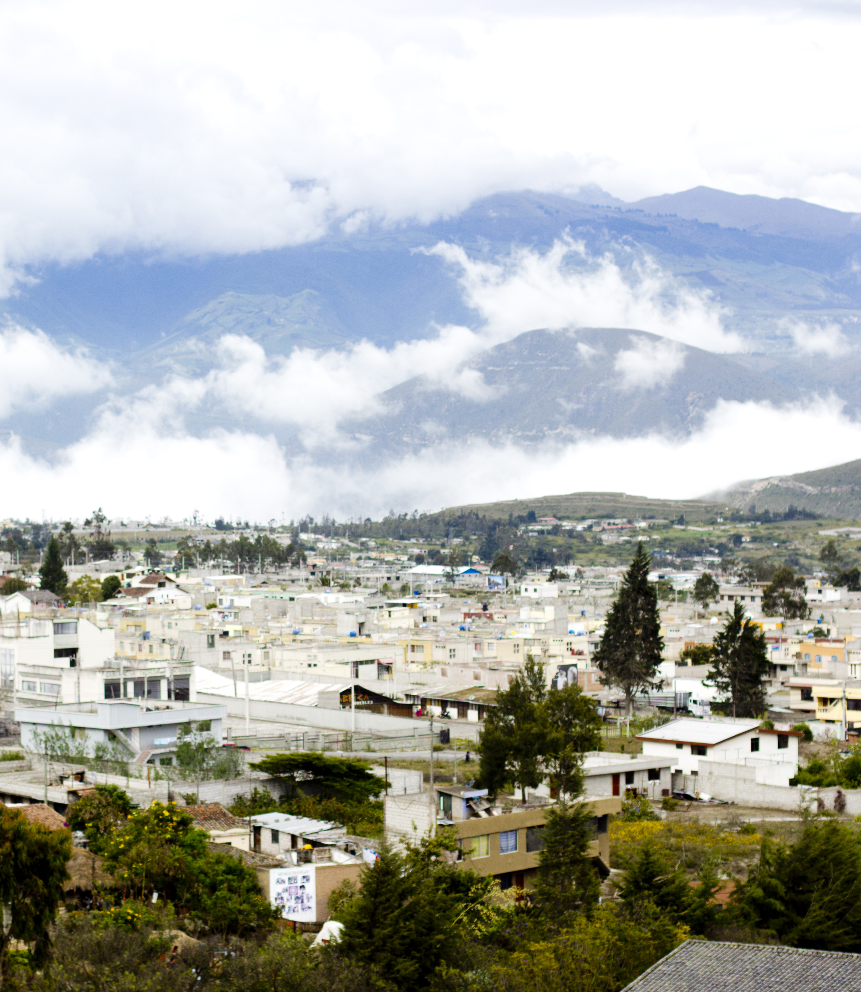
13 Characteristics
Vision capacity
  God-given vision
Personal motivation
  Self-discipline
  Planter’s responsibility

Slide 6
13 Characteristics
3. Inclusive in ministry
  Creating a sense of responsibility (ownership)
  Delegation
  No “lone rangers”
  Ecclesiastes 4:9-12
4. Outreach to nonbelievers
  Go to the lost
  Main focus is evangelism
  60-80% of time spent in relationship building

Slide 7
13 Characteristics
5. Spousal Support
  One battle or two battles?
  Case study
6. Relationship building capacity
  Sociable
  Inviting
  Taking time

Slide 8
13 Characteristics
7. Dedicated to growing the church
  Spiritual growth
  Organic growth
Mims and Martinez
  Evangelism
  Discipleship
  Ministry
  Friendship
  Worship

Slide 9
13 Characteristics
8. Responsive to the community
  Jesus’ example
  Mission Statement
  Good testimony via word and deed
9. Use of others’ gifts
  Encourages others
  Not a pastor-centric model
  Training of emerging leaders essential

Slide 10
13 Characteristics
10. Flexibility
  Ebb and flow
  “Man proposes, God disposes”
  Work with and not against others
11. Maintains unity
  Different gifts for different people
  1 Corinthians 12; Romans 12:4
  Different functions
  One body, many parts

Slide 11
13 Characteristics
12. Adaptable
  Animal world
  Romans and Greeks
  Learn language & customs
13. Lives out his/her faith
  Philippians 1:6
  God produces fruit
  Our task is to be faithful to the call

Slide 12
Comparing with other lists
Peter Wagner
Ed Stetzer
Daniel Sánchez
Redeemer Presbyterian
Stanley Wood
Aubrey Malphurs

Slide 13
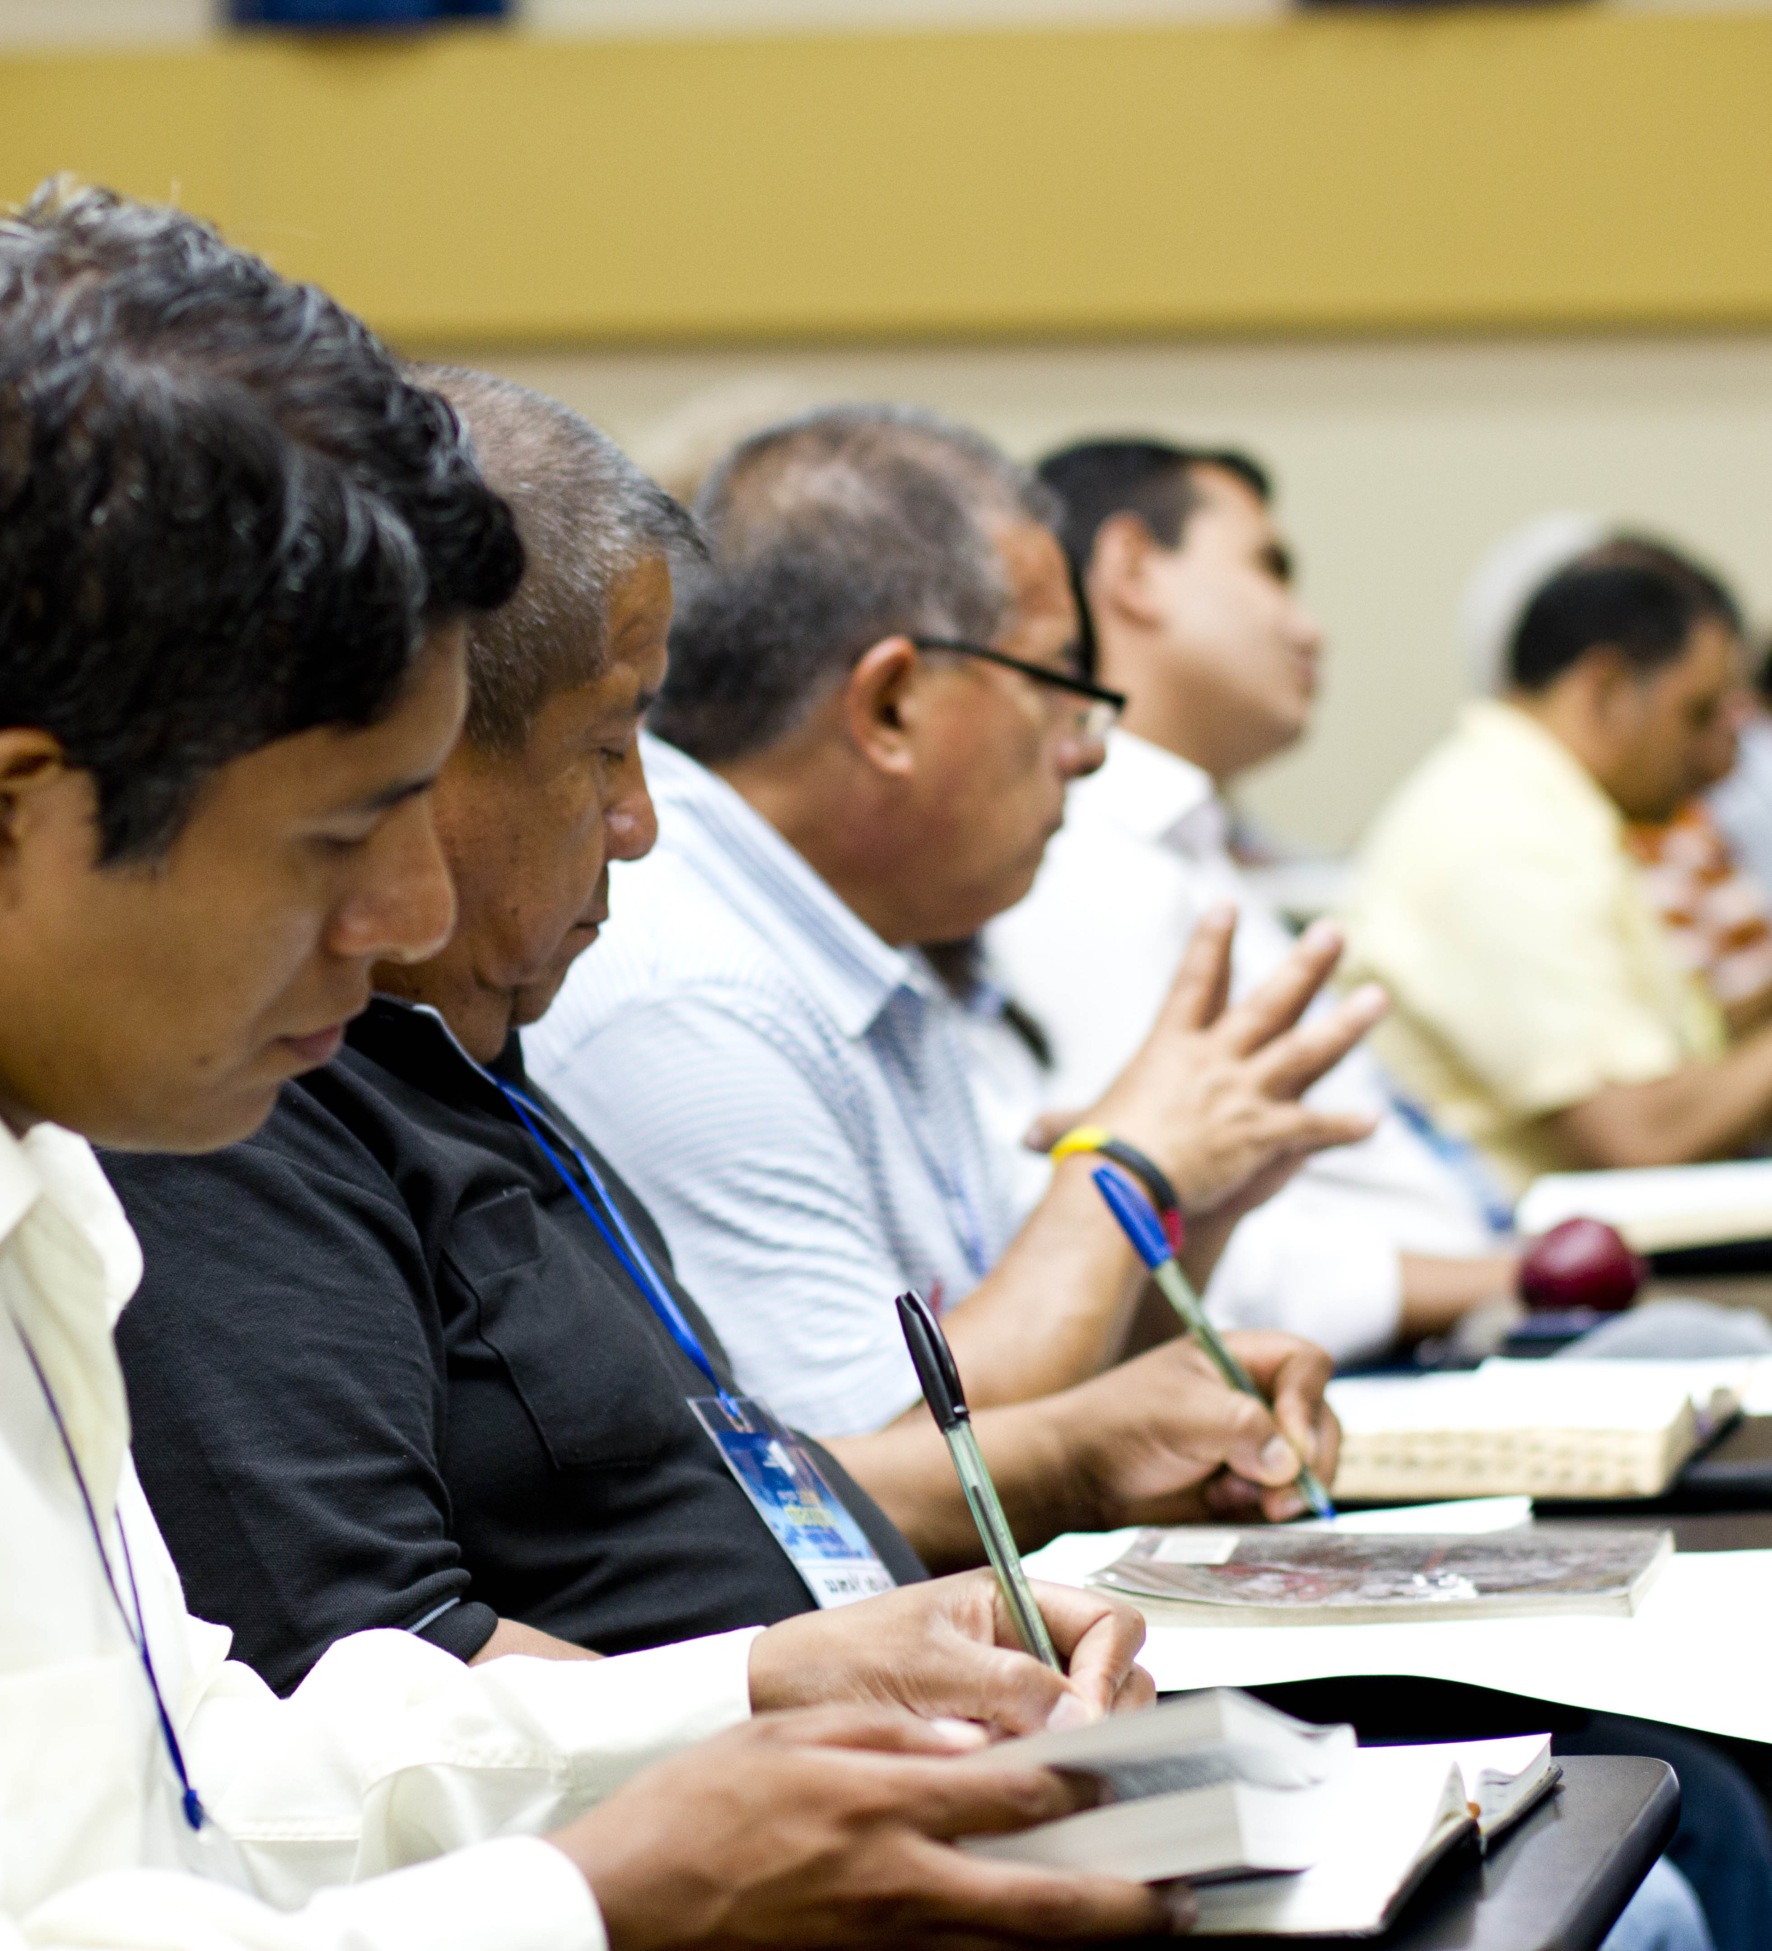
Tools to Evaluate Candidates
Using the 13 Characteristics to assess:
  Behavioral Interview
  Assessment Center

Slide 14
Behavioral Interview
“Church planters who have gone through a Ridley assessment interview lead churches that are larger in attendance than those who do not…. A new church is more likely to fail when it is started by a planter who has not been assessed. All other factors being equal, an assessment assures the selection of better church planters with a higher likelihood of success.” Stetzer, Planting New Churches in a Postmodern Age
3 to 5-hour interview
Behavioral questions
“Tell me a time when you….” (past experience)
Behavior in and outside of ministry

Slide 15
Assessment Center
2-3 days
Simulations
Behavioral interview
Intensive, fast-paced
Observation under pressure
Observation of his/her interaction with others
Additional tools
DiSC
Gift assessment
Quantifiable scoring of activities
Notes:
2-3 days
Simulations
Real-time observations instead of past experience (behavioral interview)
Intensive, fast-paced
Observation while candidate is under pressure to see what he/she really does
Observation of his/her interaction with others
Additional tools
DiSC
Gift assessment
Quantifiable scoring of activities

Slide 16
Assessment Center, continued
Elements in the Assessment Center
Survival exercise
Demographic investigation
Vision casting exercise
Strategy design
Conflict resolution
Gospel presentation
Grand Opening message

Slide 17

Role of Formal Institutions
Academic preparation combined with practicum
Study/Practice/Reflection model
Adult learners and “teachable moments”

Slide 18
Role of Non-formal Teaching/Learning
TEE
Church Planter Retreats (Bootcamps)
Modular training
Mentor/coaching of church planters

