Slide 1


Slide 2
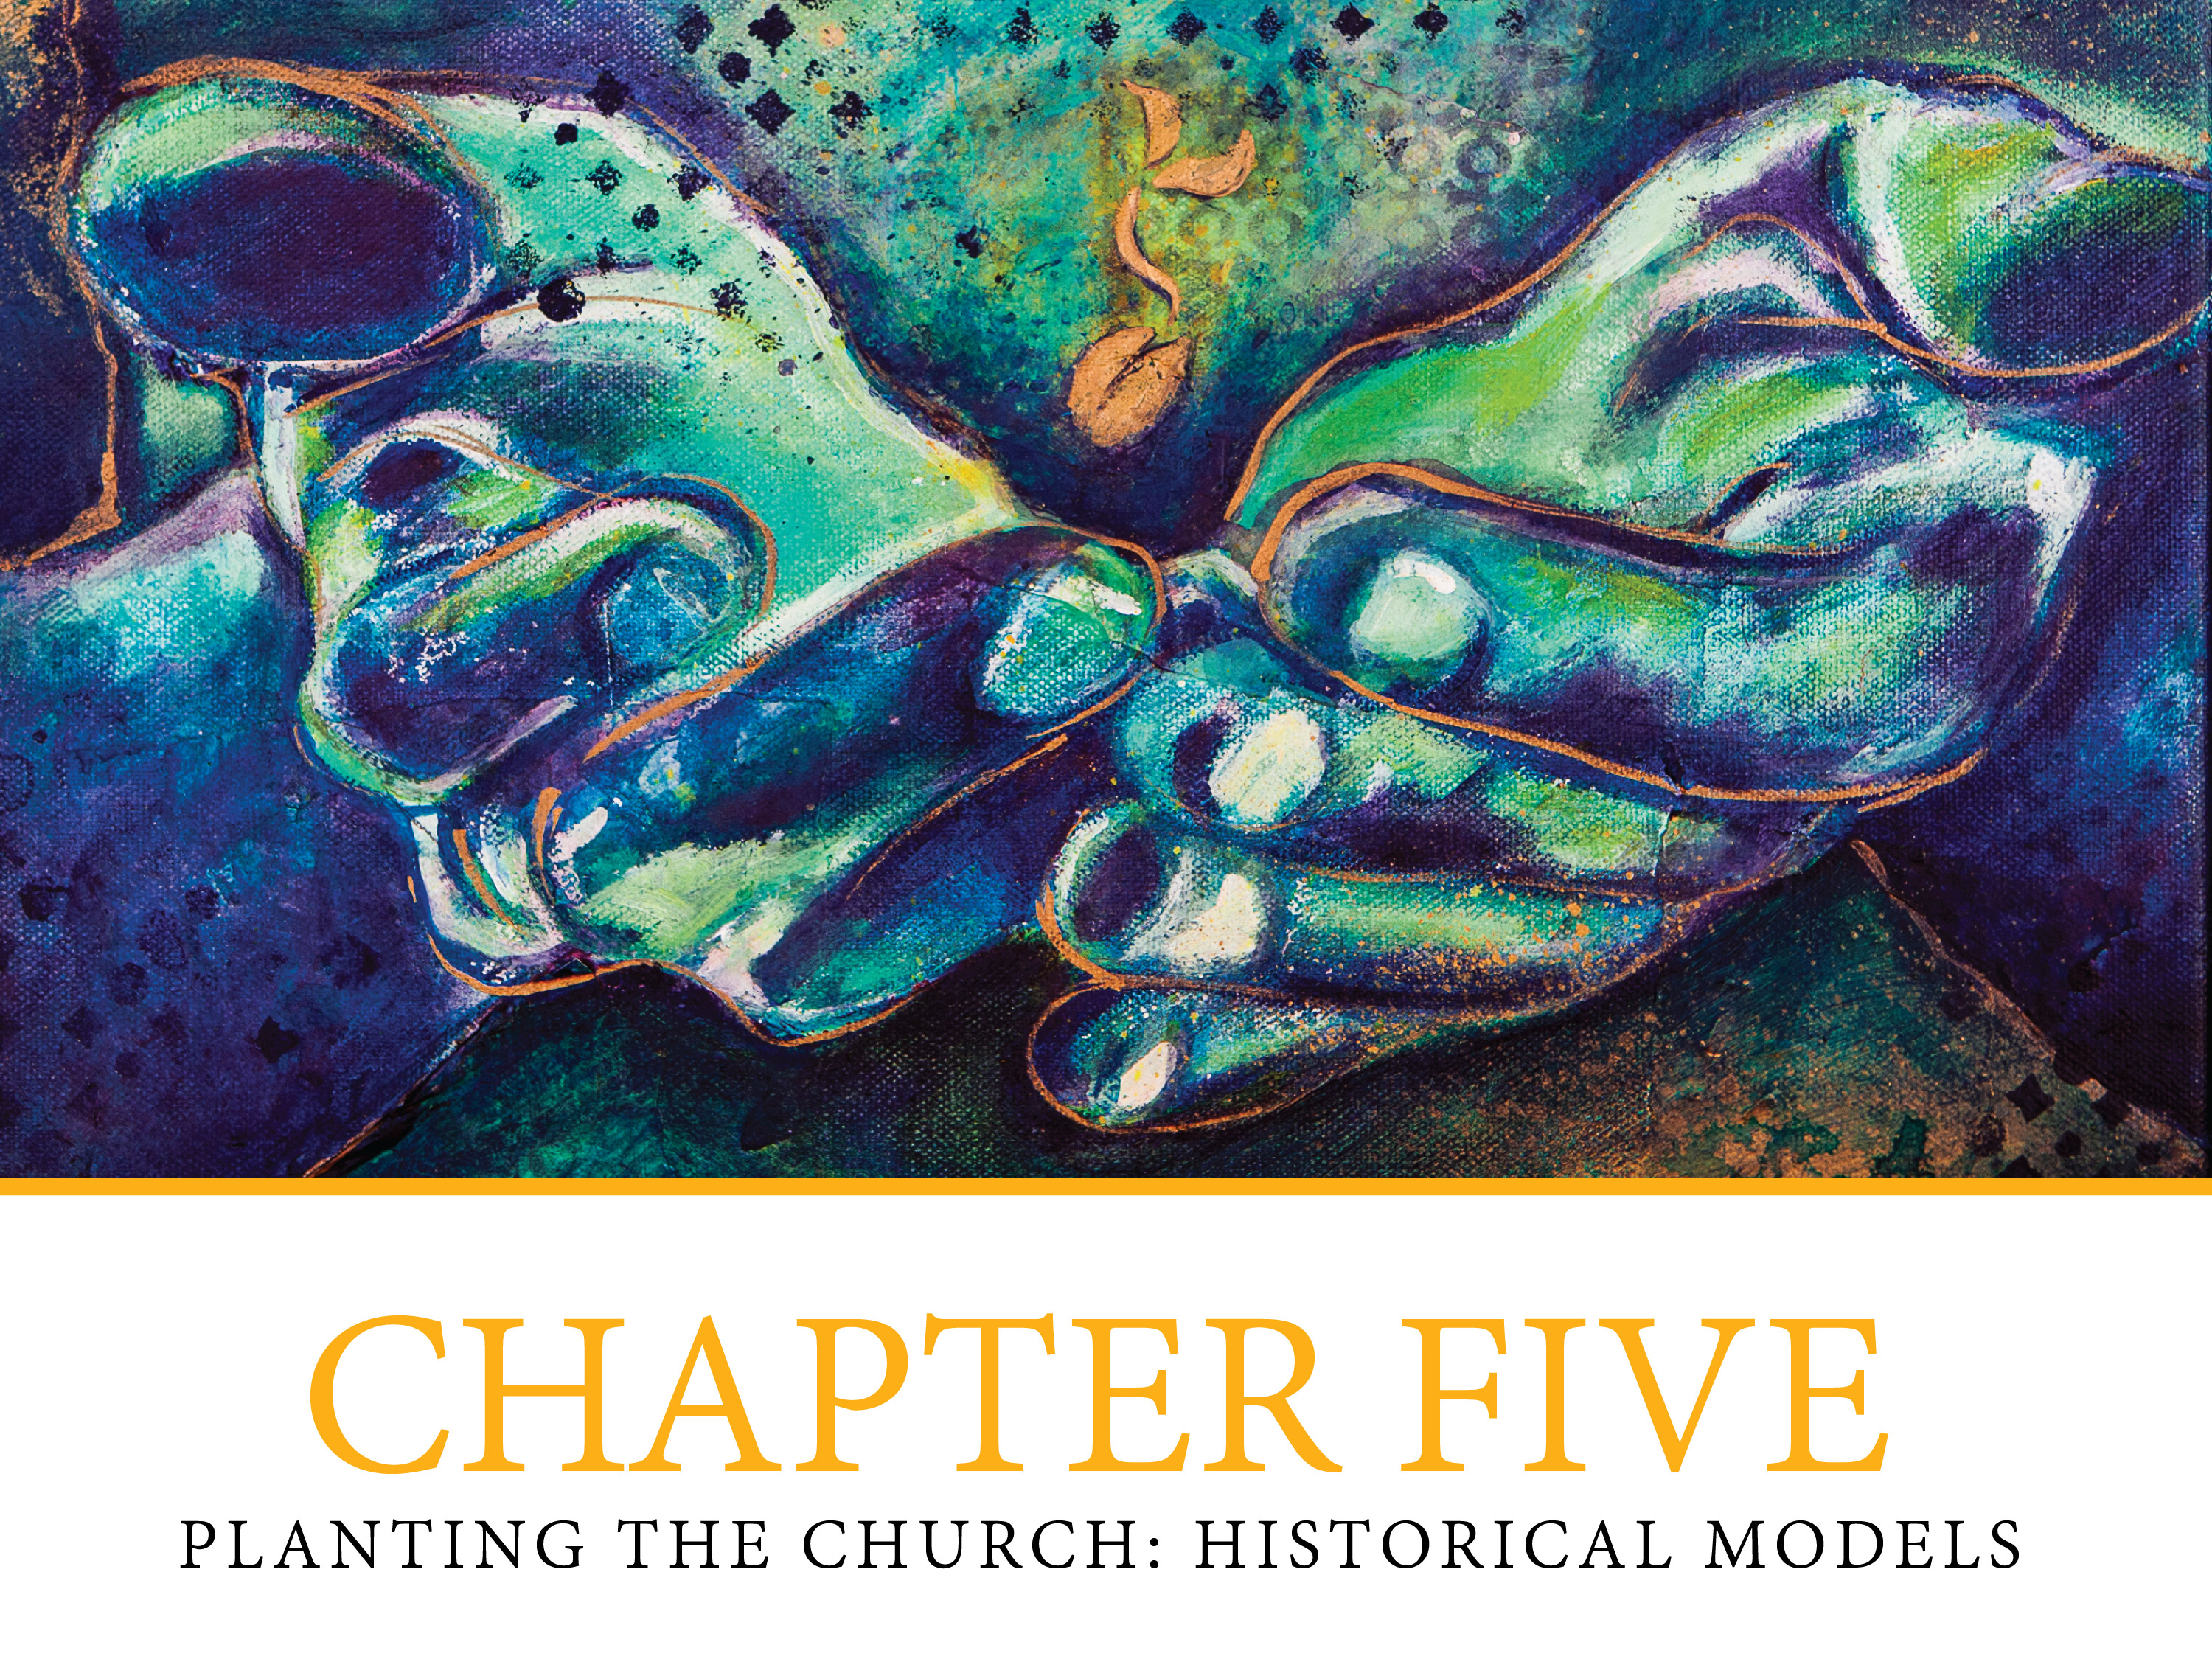

Slide 3

Historical Models of Evangelization & Church Planting
A. Testimonial model
  Public testimonies
  Testimony of leaders
  Missionaries
  Others

Slide 4
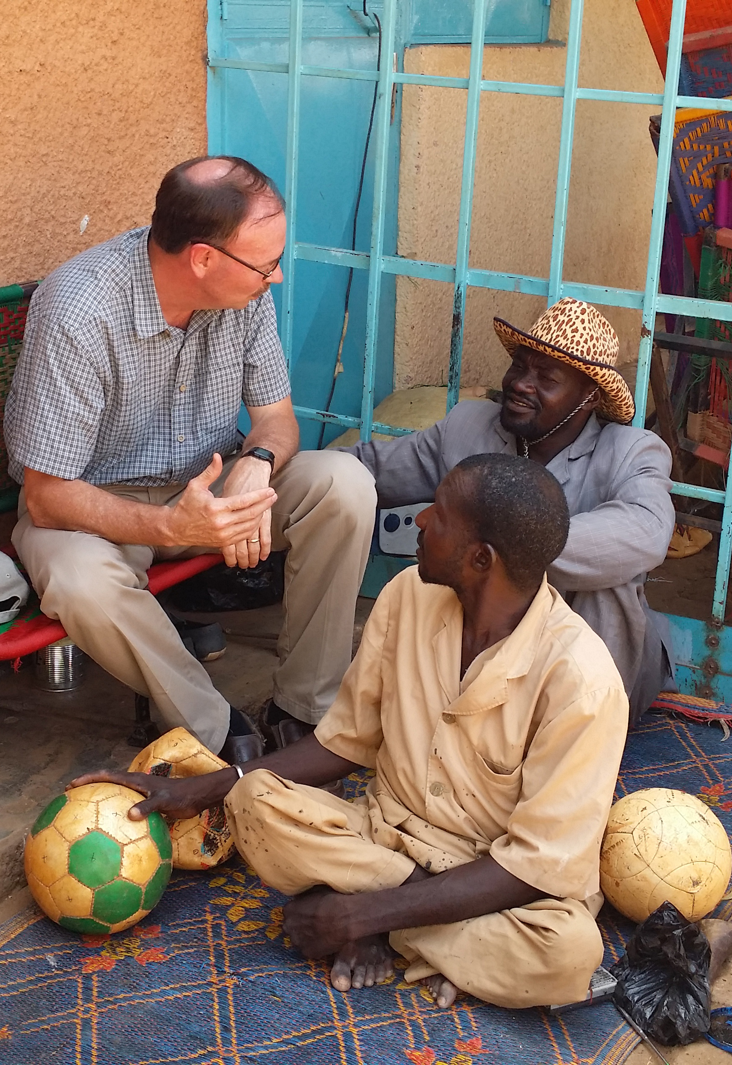
Historical Models, continued
B. Apologetical model
  Justin Martyr, Tatian, Irannaeus, Tertullian
  Clement of Alexandria, Origen
  Others
  Life witness
  Focused on Jesus

Slide 5
Historical Models, continued
C. Monastic model
  Desert fathers
  Non-orthodox Nestorians
  Constantine, fall of Rome
  Augustine

Slide 6
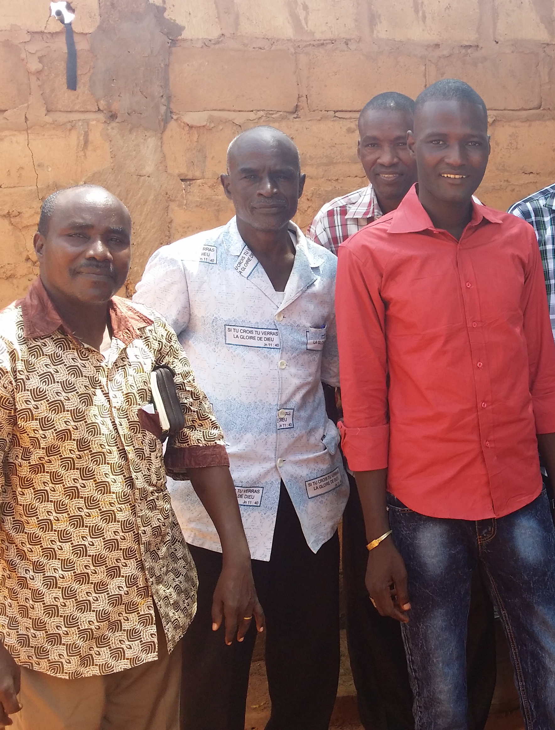
Historical Models, continued
D. Communal model
  Whole tribes
  People movements
  catechisms
    Apostle’s Creed
    Lord’s Prayer
    Ten Commandments
  local languages
  Order of Cluny
  Aristotelian worldview

Slide 7
Historical Models, continued
E. Teaching model
  Dominicans
  Thomas Aquinas
  Raymond Lull
  Bartolomé de las Casas

Slide 8
Historical Models, continued
F. Servant model
  Franciscans
  Poverty
  Rule of the Order
  “Make me an instrument…”

Slide 9
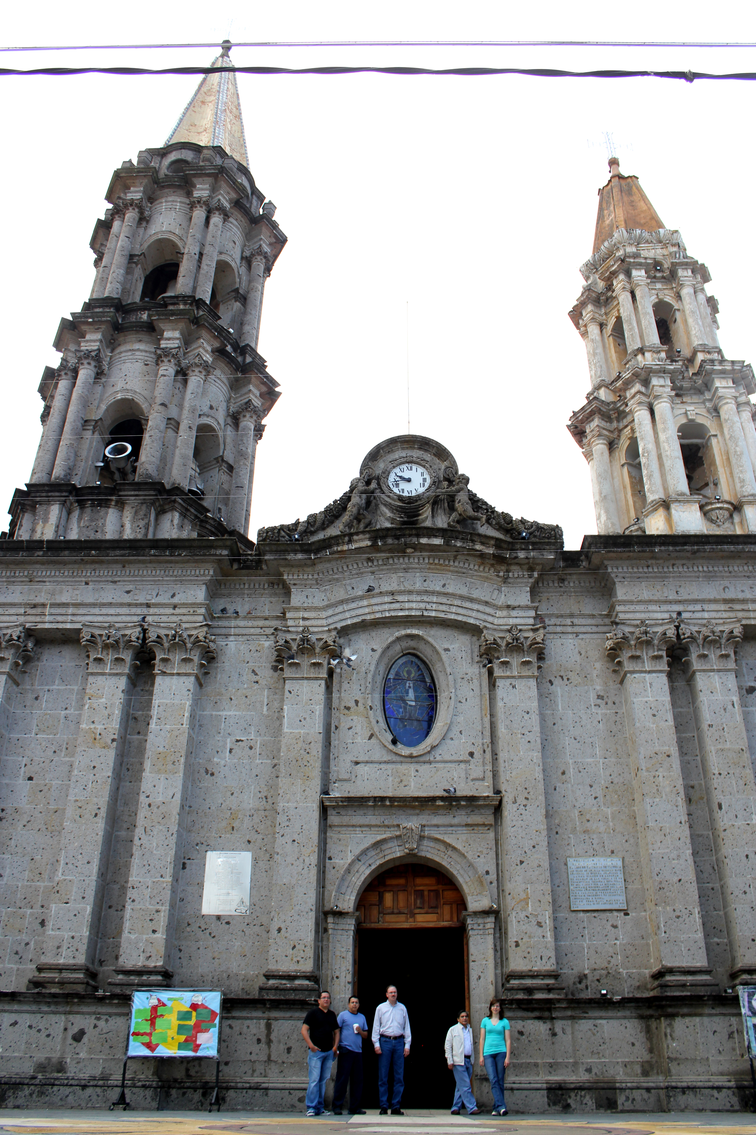
Historical Models, continued
G. Artistic model
  Architecture
  “Mystery Cycles”
  The Hours
  Morality plays
  Painting

Slide 10
Historical Models, continued
H. Mystical model
  Francis of Assisi
  Raymond Lull
  Cisneros, Teresa of Avila
  John of the Cross
  Loyal and the Jesuits
  Engagement with the world
  Spiritual Exercises
  Sadhu Sundar Singh
  Kimbangu

Slide 11
Historical Models, continued
I. Kerygmatic model
  Birth of the new age in the West
  Knowledge of the classics
  Increased commerce between East and West
  Religious crusades
  A new worldview
  Exploration of Africa and the New World
  Invention of the printing press with movable type
  Breakdown of papal supremacy
  Rise of nationalism

Slide 12
Kerygmatic Model, continued
Kerygma: the announcement of the gospel
Reformation and mission
  Calvin
  Voetius
  Missio Dei

Slide 13
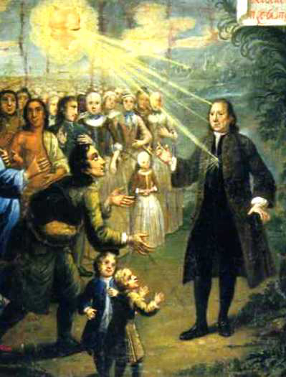
Historical Models, continued
J. Pietist model
  “Further Reformation” movement
  Count Zinzendorf and the Moravian Community
“Moravians.” Sunbury: A History. 2014. http://www.departments.bucknell.edu/environmental_center/sunbury/website/Moravians.shtml

Slide 14
Historical Models, continued
K. Imperial model
  “Royal patronage”
  Line of Demarcation
  Dominicans, Franciscans, Jesuits, Augustinians
  “secular” and “regular” priests
  Bartolomé de las Casas as “Apostle to the Indians”

Slide 15
Historical Models, continued
L. Cultural Adaptation model
  Jesuits and accommodation
  Francis Xavier
  Matteo Ricci
  Nobili
  Rife between pope and emperor (China)

Slide 16
Historical Models, continued
M. Colonial model
  Priests and soldiers
  Paternalism in Paraguay
  East and West Indies Companies
  David Livingstone
  John Elliot

Slide 17
Historical Models, continued
N. Mission society model
  Society for the Propagation of the Gospel
  World Missions Conference
  British and foreign Bible Society
  American Bible Society

Slide 18
Historical Models, continued
O. Church model
  Churches planting churches
  Missio Dei re-discovered
  Struggles between missions and national churches
  Lack of training of national leaders

Slide 19

Historical Models, continued
P. Institutional model
  Age of optimism
  Christ’s imminent return
  Education, principal mode of evangelism
  Communal living in compounds

Slide 20
Historical Models, continued
Q. Contextual models: Adaptation and Enculturation
  Analysis of those to be evangelized
  Contact points
  Adaptation
  Truths of the gospel are constant and permanent
  Pedagogical approach

Slide 21
Contextual Models, continued
  Enculturation
  “Coming of the Third Church”
  Self-theologizing added to the “3 Self’s”

Slide 22
Historical Models, continued
R. Spontaneous Evangelism model
African Independent Churches
Pentecostals in Latin America
Expulsion of missionaries from China

Slide 23
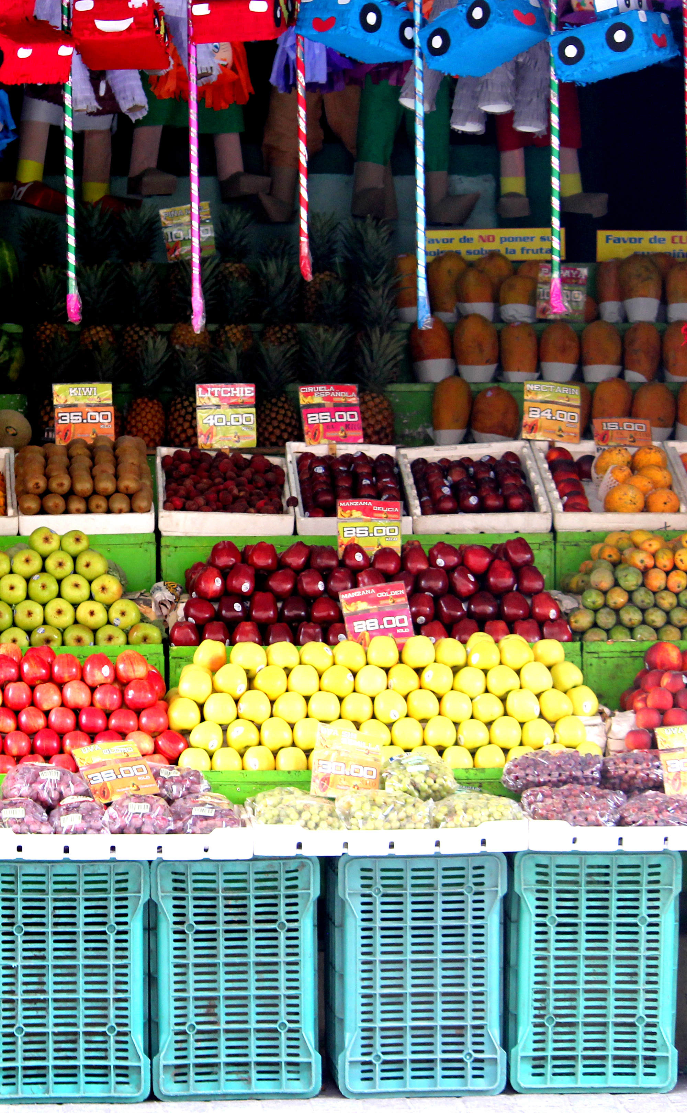
Principles for Use of the Models
Diversity of models
Unrepeatable historical circumstances
No single approach
Quality and authenticity
Divergent theologies and ecclesiologies
Distinction between sending/receiving mission agencies
Room for new models

