Slide 1


Slide 2


Slide 3

Church Planting in the Early Church
Hirsch
Tertullian
Martyrdom
The “apologists”

Slide 4
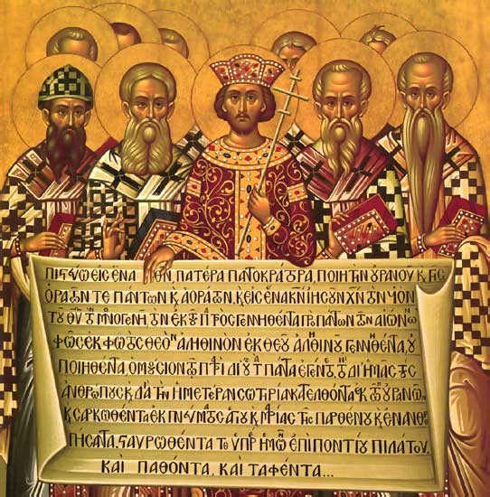
Church Planting from Constantine to the Reformation
Battle of Milvian Bridge/Edict of Milan
  After military orders (e.g. “diocese”)
  Benedict
  Augustine
  The Eastern expansion
  The rise of Islam
"A Declaration of Tolerance." MercatorNet. October 25, 2013. http://www.mercatornet.com/articles/view/a_declaration_of_tolerance​
Notes:
Battle of Milvian Bridge/Edict of Milan
After the military orders (e.g. “diocese”)
Benedict
Augustine
The Eastern expansion
The rise of Islam

Slide 5
Church Planting from Constantine to the Reformation
The Crusades/The Inquisitions
  The monastic orders
Colonization of the New World
Expansion into Africa and China
Gutenberg

Slide 6
Church Planting During and After the Reformation
The Pre-Reformers
The Reformers
  Church planting
  Huguenots
  Anabaptists
  Counter-Reformation

Slide 7
Church Planting in the 18th and 19th Centuries
The Separatists
  Puritans and Pietists
  Baptists
  Quakers
  Moravians and Count Zinzendorf

Slide 8
“You are not to aim at the conversion of whole nations: you must simply look for seekers after the truth, who, like the Ethiopian eunuch, seem ready to welcome the Gospel. Second, you must go straight to the point and tell them about the life and death of Christ. Third, you must not stand aloof from the heathen, but humble yourself, mix with them, treat them as Brethren, and pray with them and for them.. . . . . And how is it that missionaries have failed in the past? They failed because, instead of preaching Christ, they have given lectures on theology.”
(J. D. Payne quotes Zinzendorf)

Slide 9
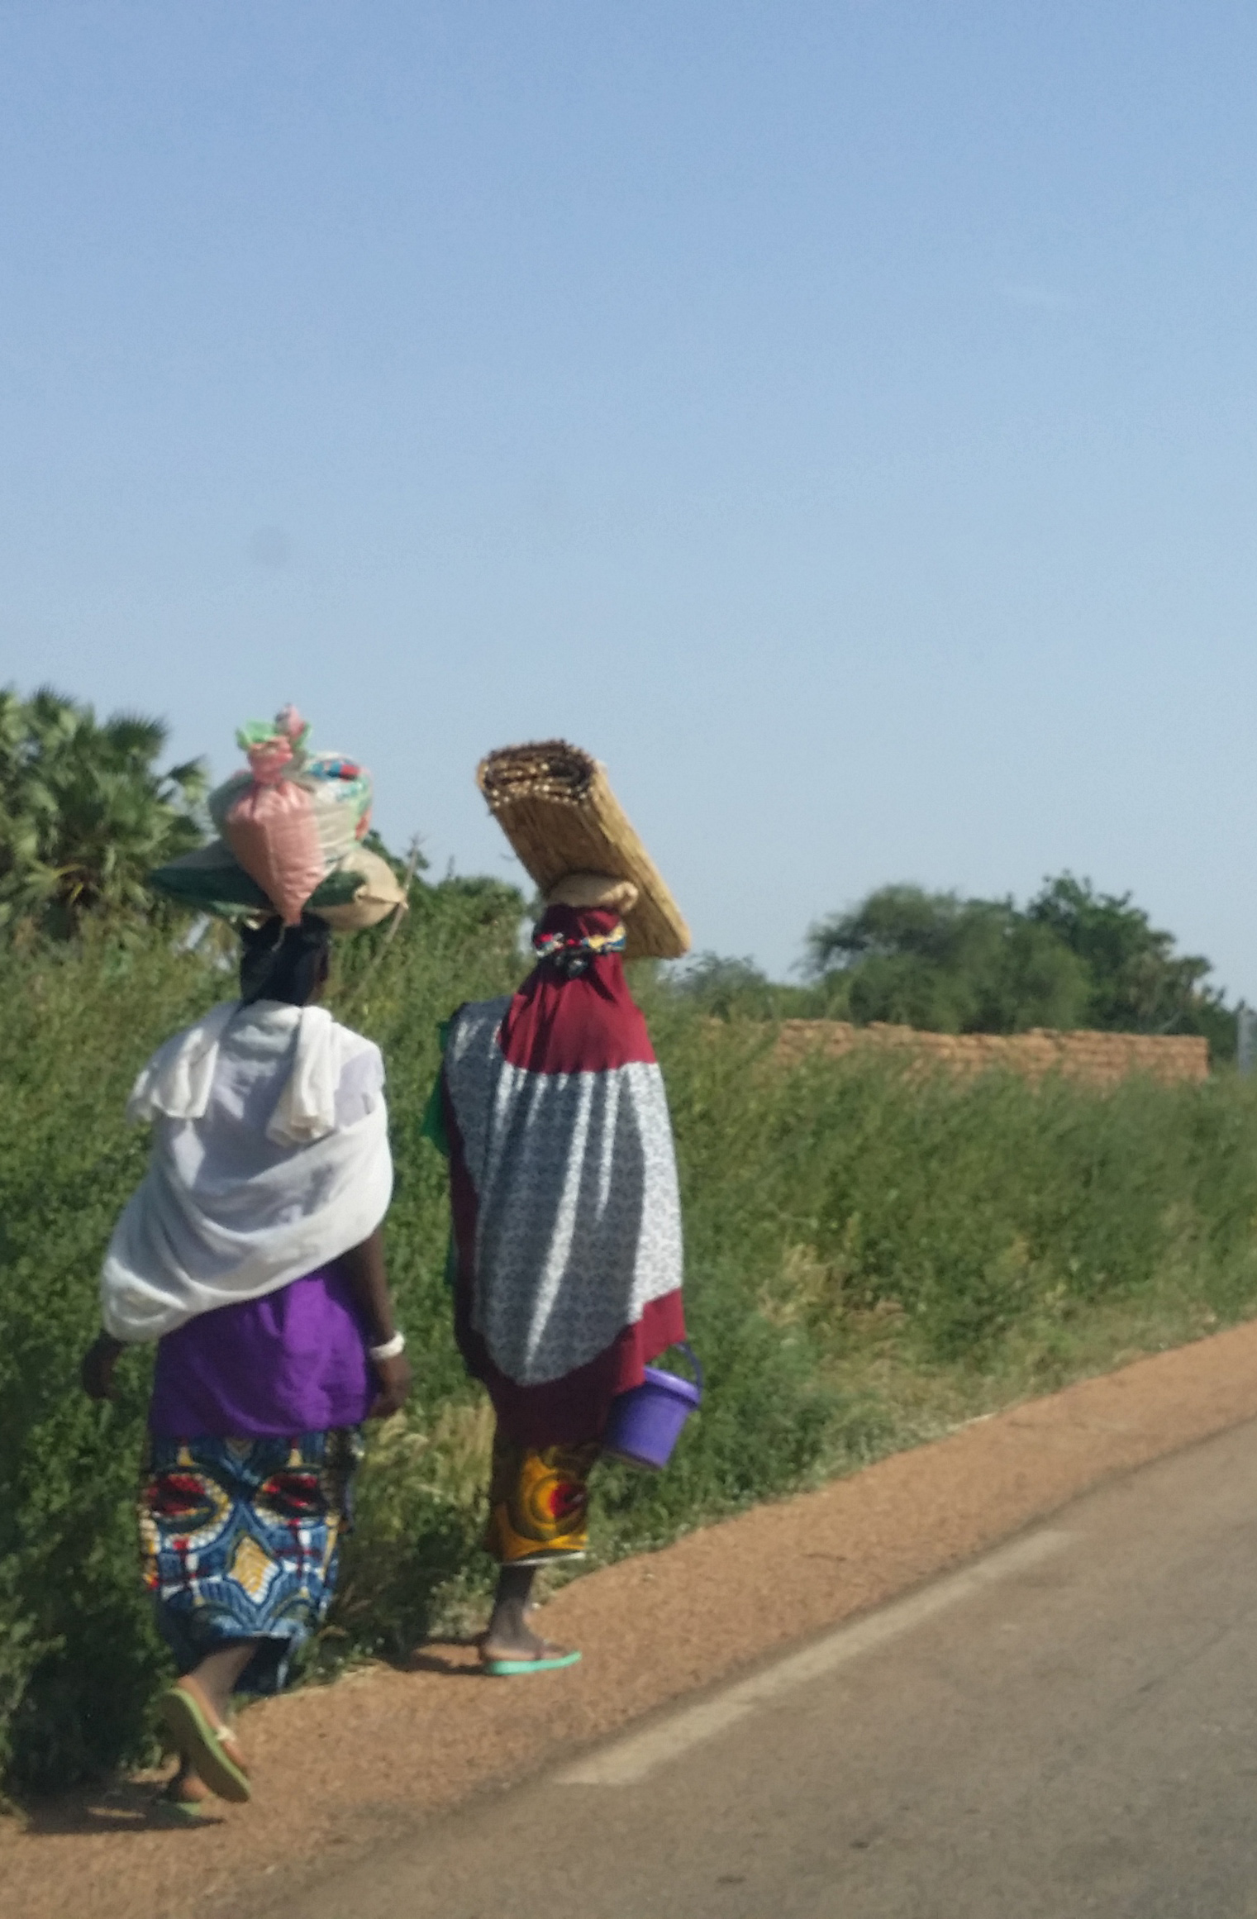
Moravian Church Planting Methods
Mission stations
Team approach
Acts of need
Keeping it simple
Long-term perspective
Cultural acquisition and language learning
Bible translation
Missionary zeal
Priority of prayer
Sheep stealing not allowed
Tent-making
Missionaries the norm, not the exception

Slide 10
The Great Awakening
  The Wesleys
  Jonathan Edwards
  George Whitefield
The Second Great Awakening

Slide 11
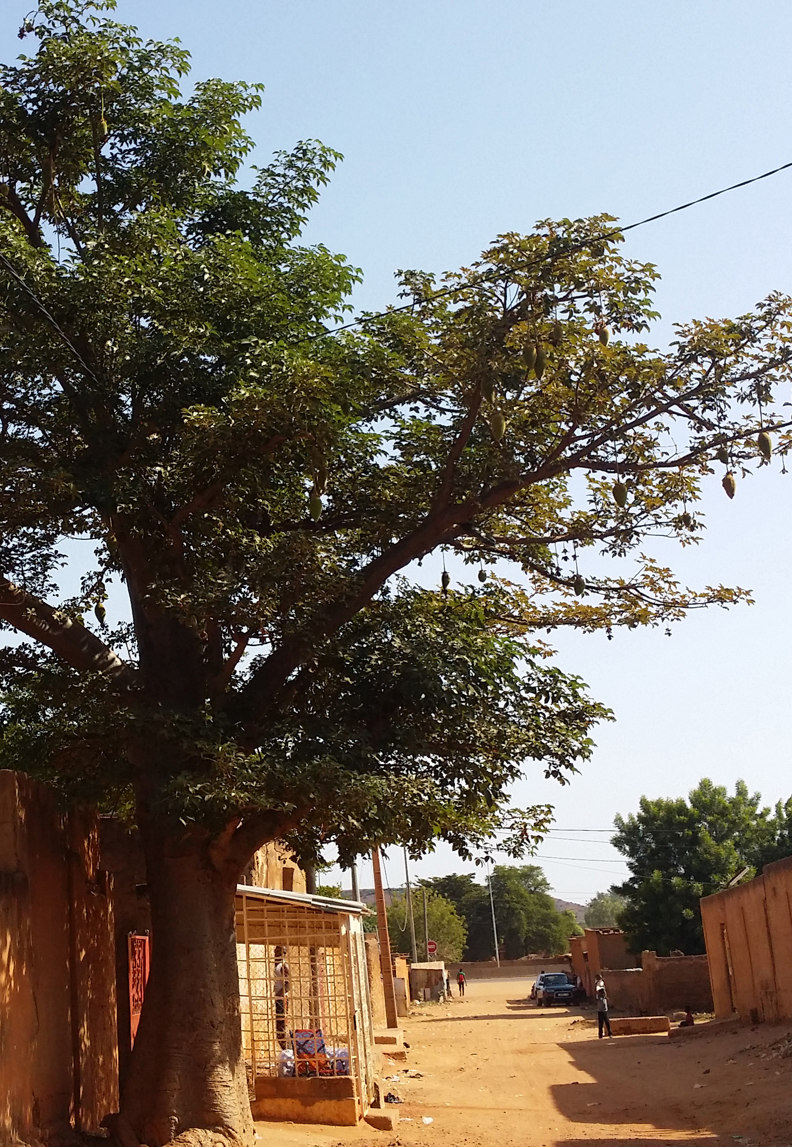
Baptist Church Planting Methods
Mother churches
Hiving off
Arms and branches
Traveling churches
Colonization
Non-professional church planters
Missional pastors
Plant and pastor
Gather the scattered
Association

Slide 12
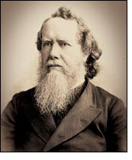
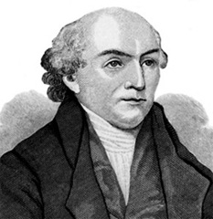
Modern Missions
Hudson Taylor (top)
William Carey (bottom)
Western acculturation
“Hudson Taylor: Faith Missionary to China.” Christianity Today. August 8, 2008.http://www.christianitytoday.com/ch/131christians/missionaries/htaylor.html
“Who was William Carey?” Carey. 2014. http://www.carey-edu.ca/william-carey/

Slide 13
Church Planting in the 20th Century
The Pentecostal movement
The “3 Waves” of Pentecostalism

Slide 14
In the last days…
Ex-culturation of Christianity in the West
The church in the Majority World (the Global South)
Watchman Nee
China today
Africa today

