Slide 1


Slide 2
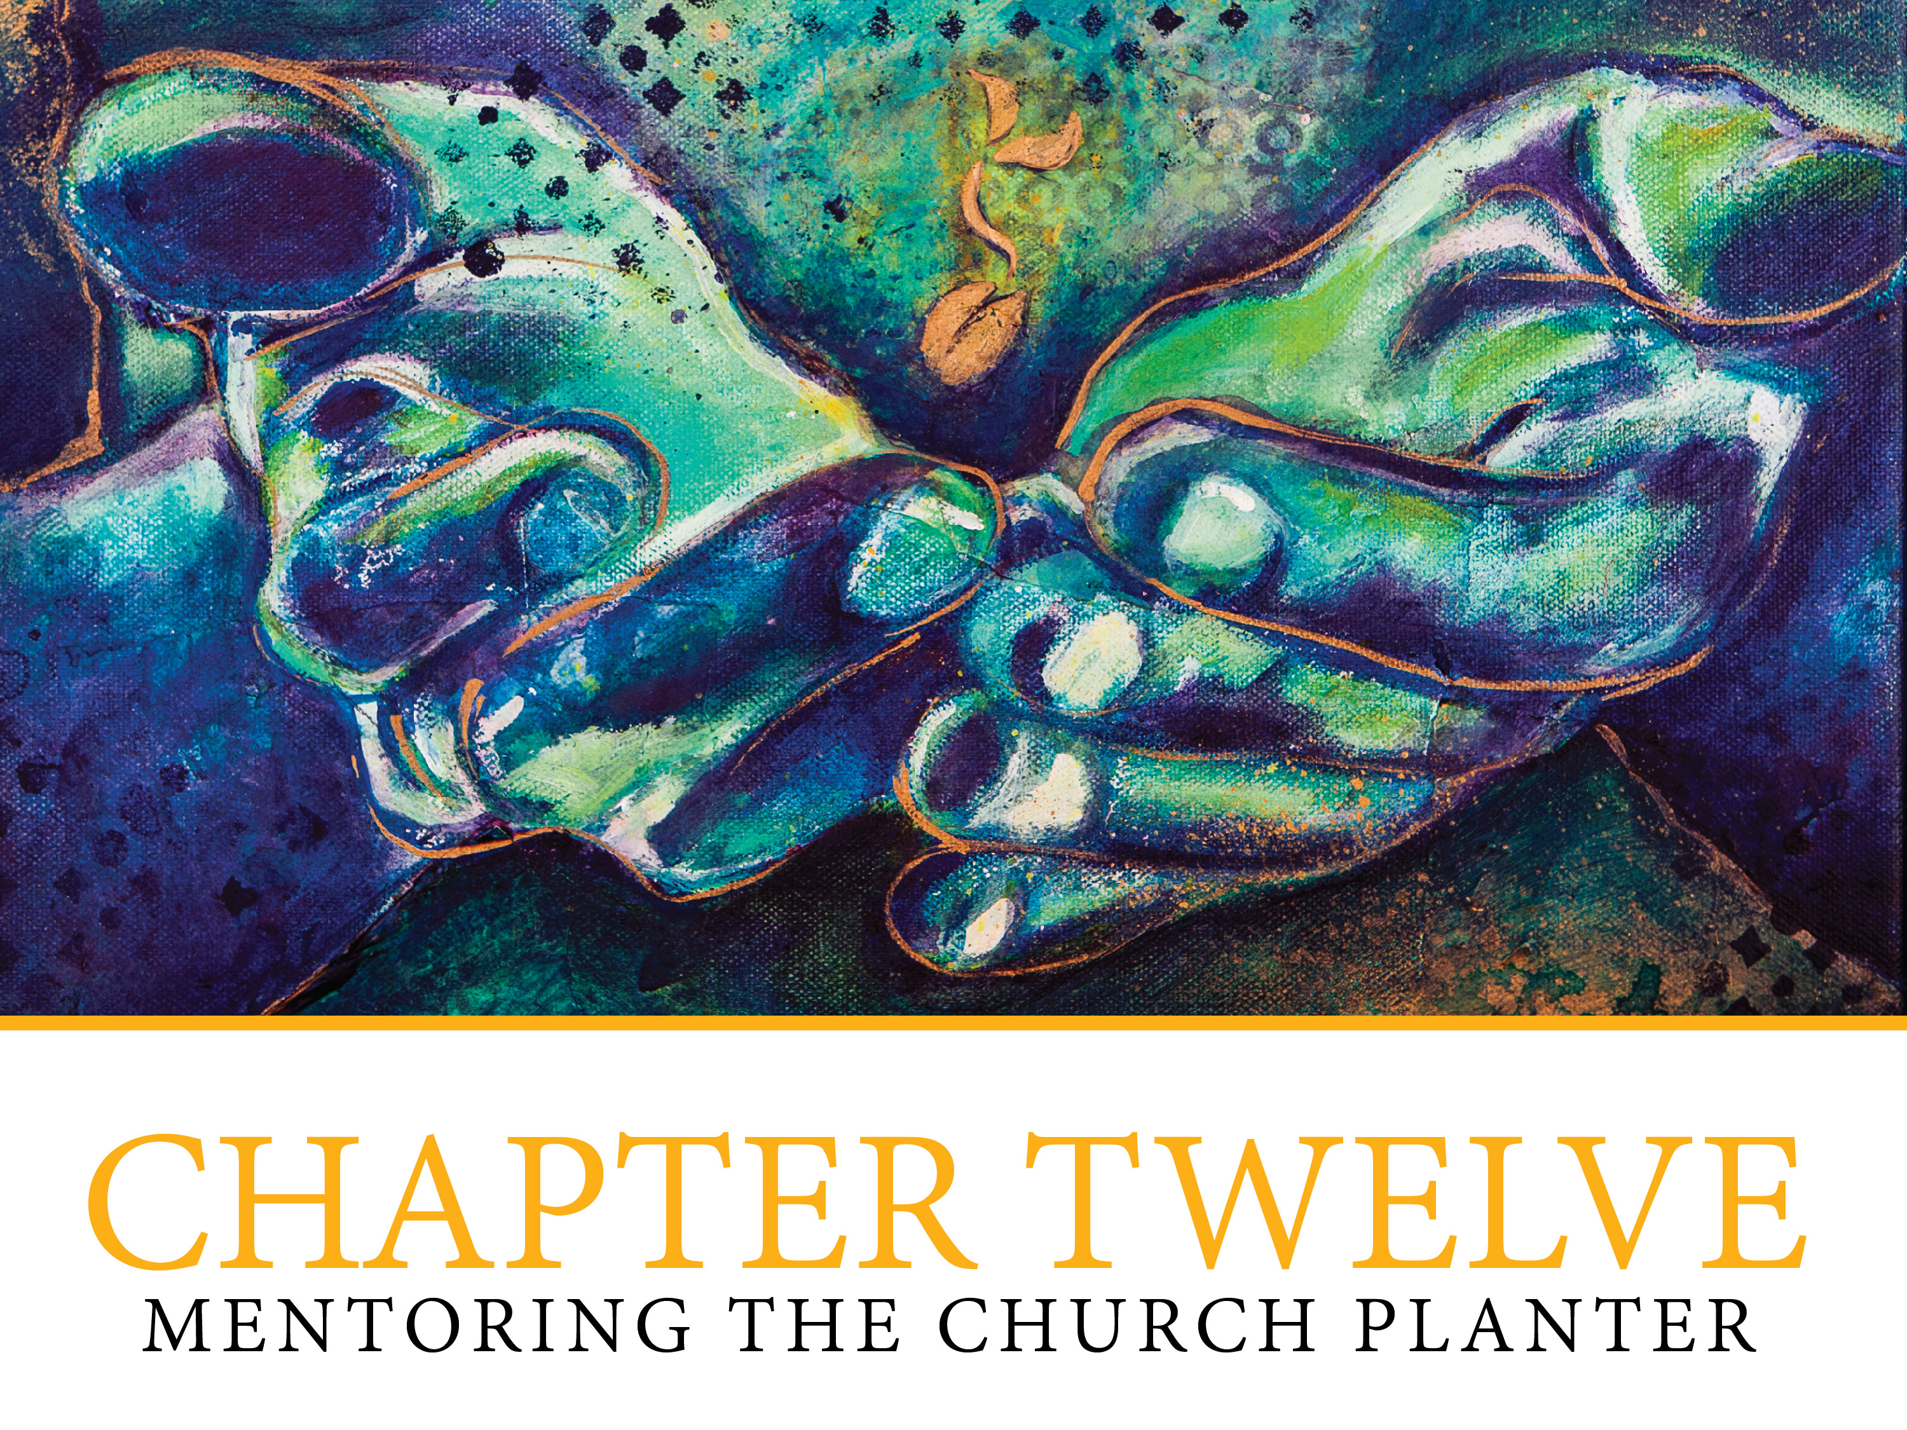

Slide 3

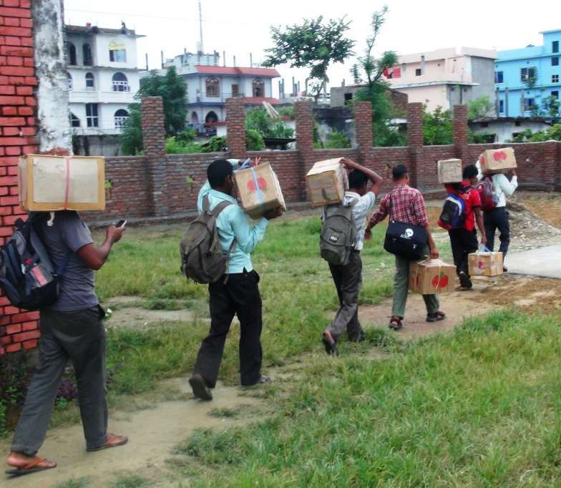
MENTORING THE CHURCH PLANTER
Defining:
Mentoring
Mentor
Mentee

Slide 4
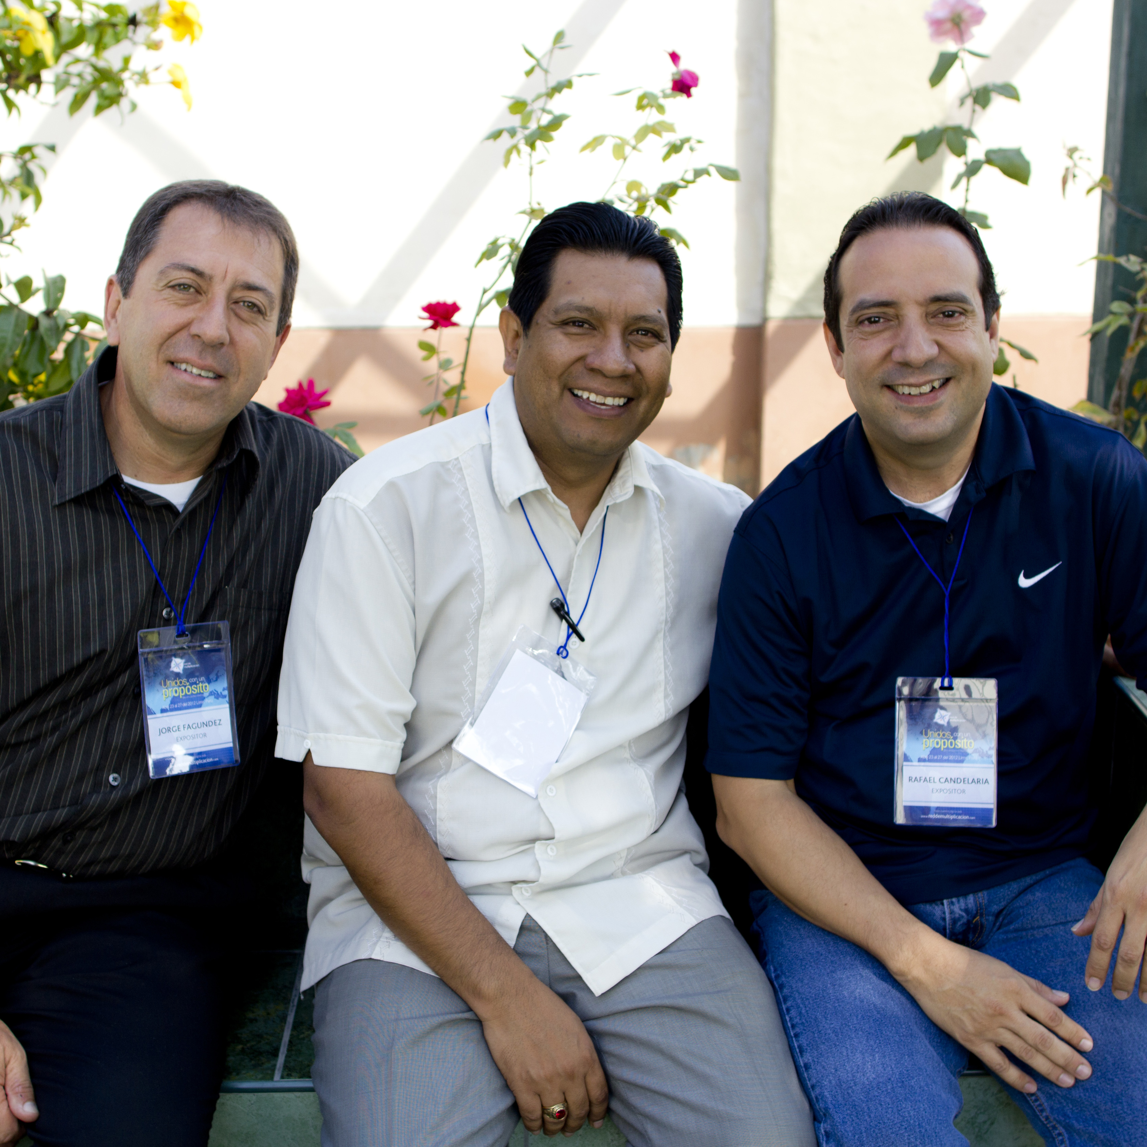
Mentoring relationships
Spiritual mentoring
Examples

Slide 5
What makes for a good mentor?
A good listener
Deals with the “just-in-time” moments
Serve as a midwife
Helps the church planter see options
Inspires
Is a critical thinker

Slide 6
Mentor behaviors to avoid
Giving advice too freely
Criticizing
Rescuing
Sponsoring inappropriately
Building unnecessary barriers
Ignoring the “why”
Discounting

Slide 7
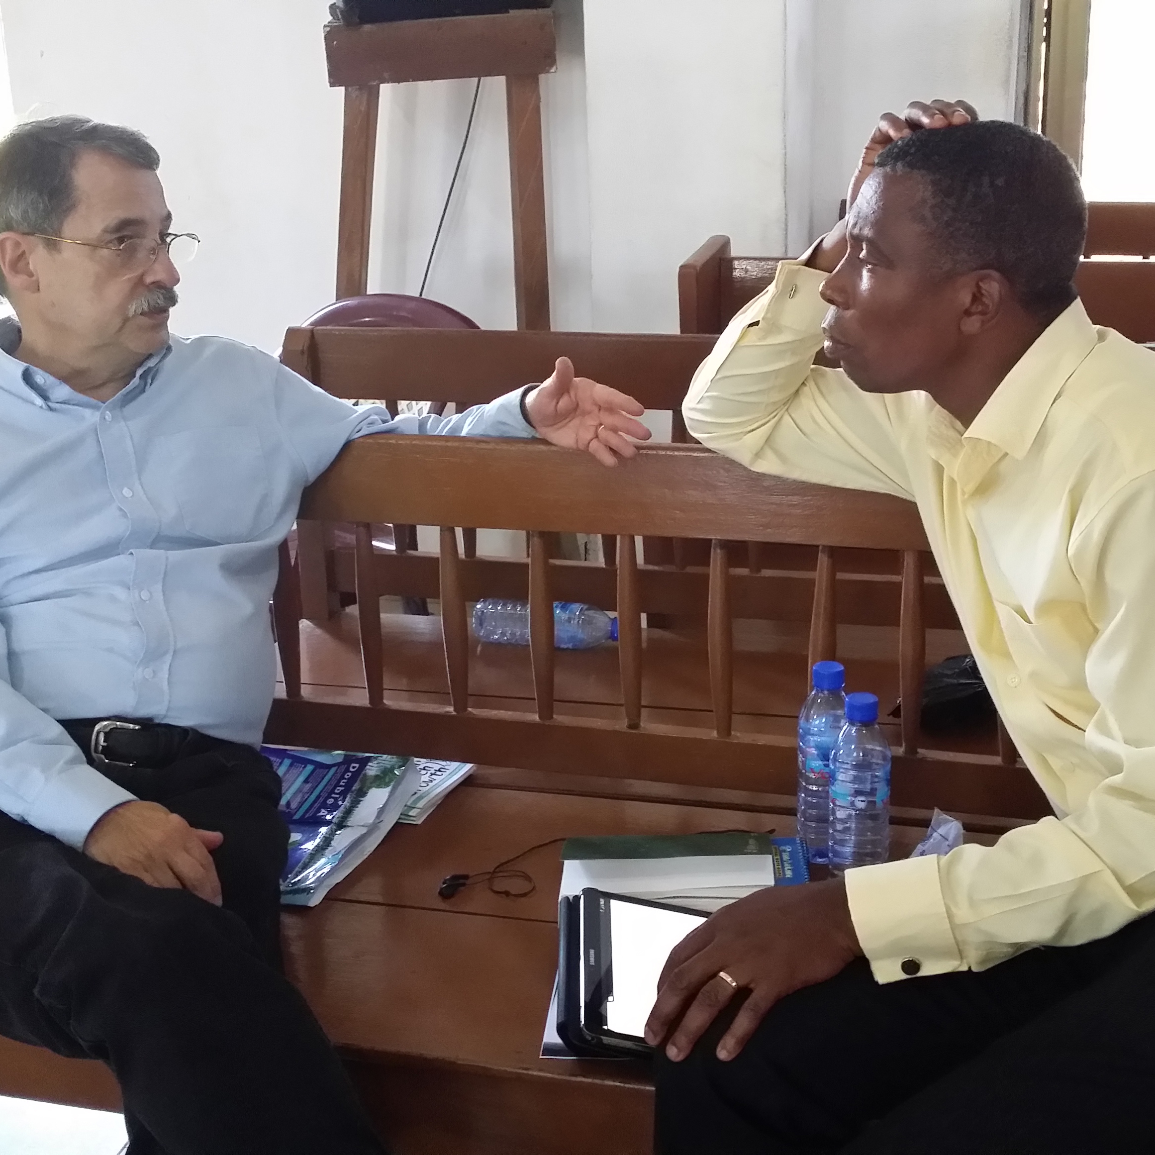
What makes for a good mentee?
Being personally responsible for learning
An active listener
A proactive learner
A lifelong learner
Transparency

Slide 8
Descriptions of a mentoring relationship
  9 ways in which a mentor helps a mentee
Benefits of a mentoring relationship
Dynamics of a mentoring relationship

Slide 9
A Mentoring Theoretical Framework
Mentoring Elements | Changing Paradigm | Adult Learning Principle
Mentee Role | From: Passive To: Active Partner | Adults learn best when they are involved in diagnosing, planning, implementing and evaluating their own learning.
Mentor Role | From: Authority To: Facilitator | The role of the facilitator is to create and maintain a supportive climate that promotes the conditions necessary for learning to take place.
Learning Process | From: Mentor-directed, with mentor responsible for mentee’s learning To: Self-directed, with mentee responsible for own learning | Adult learners have a need to be self-directing.
Length of Relationship | From: Calendar-focused To: Goal-determined | Readiness for learning increases when there is a specific need to know.

Slide 10
A Mentoring Theoretical Framework
Mentoring Elements | Changing Paradigm | Adult Learning Principle
Mentoring Relationship | From: One Life = one mentor = one mentee To: Multiple mentors over a lifetime and multiple models for mentoring individual, group, peer models. | Life’s reservoir of experience is a primary learning resource: the life experiences of others add enrichment to the learning process.
Setting | From: Face-to-face To: Multiple and varied venues and opportunities | Adult learners have an inherent need for immediacy of application.
Focus | From: Product oriented: knowledge transfer and acquisition To: Process oriented: Critical reflection and application | Adults respond best to learning when they are internally motivated to learn.

Slide 11
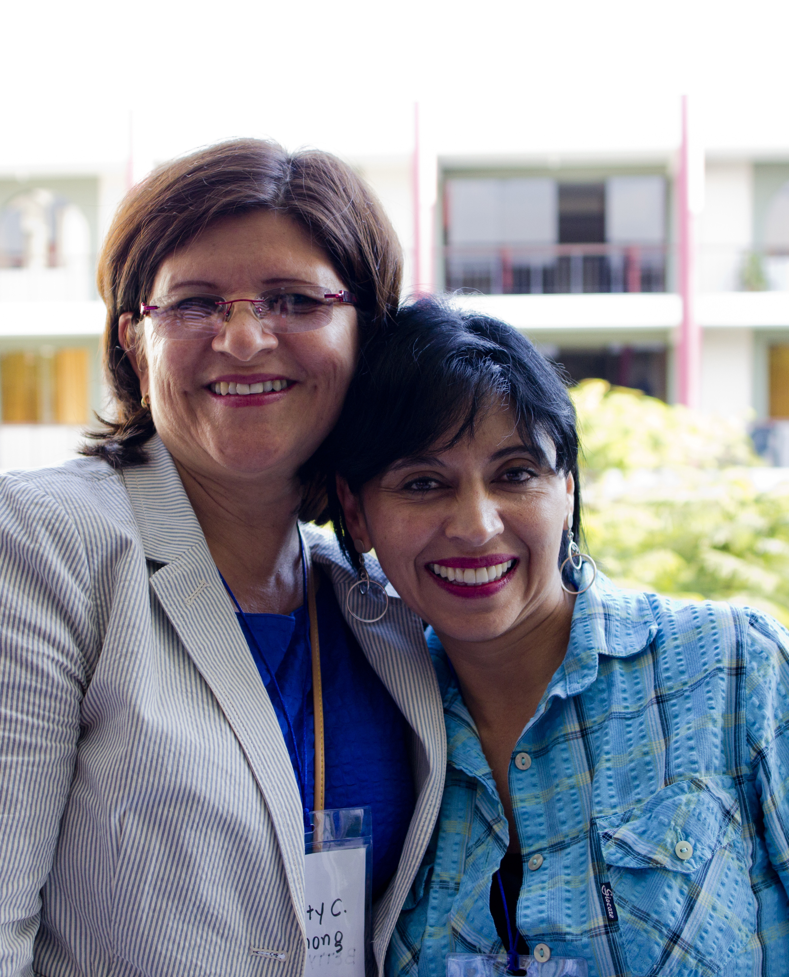
Do’s and Don’t’s of mentoring
As a mentor (relationally)
  Respect
  Value
  Trust
  Model
  Affirm
  Encourage
  Inspire
  Pray

Slide 12
As a mentor (related to skills)
Listen
Ask
Clarify
Draw out
Have an agenda
Give time
Guide
Review
Resource

Slide 13
As a mentee (relationally)
Be transparent
Be open to suggestions
Be realistic
Be your own person
Listen to the Spirit’s leading

Slide 14
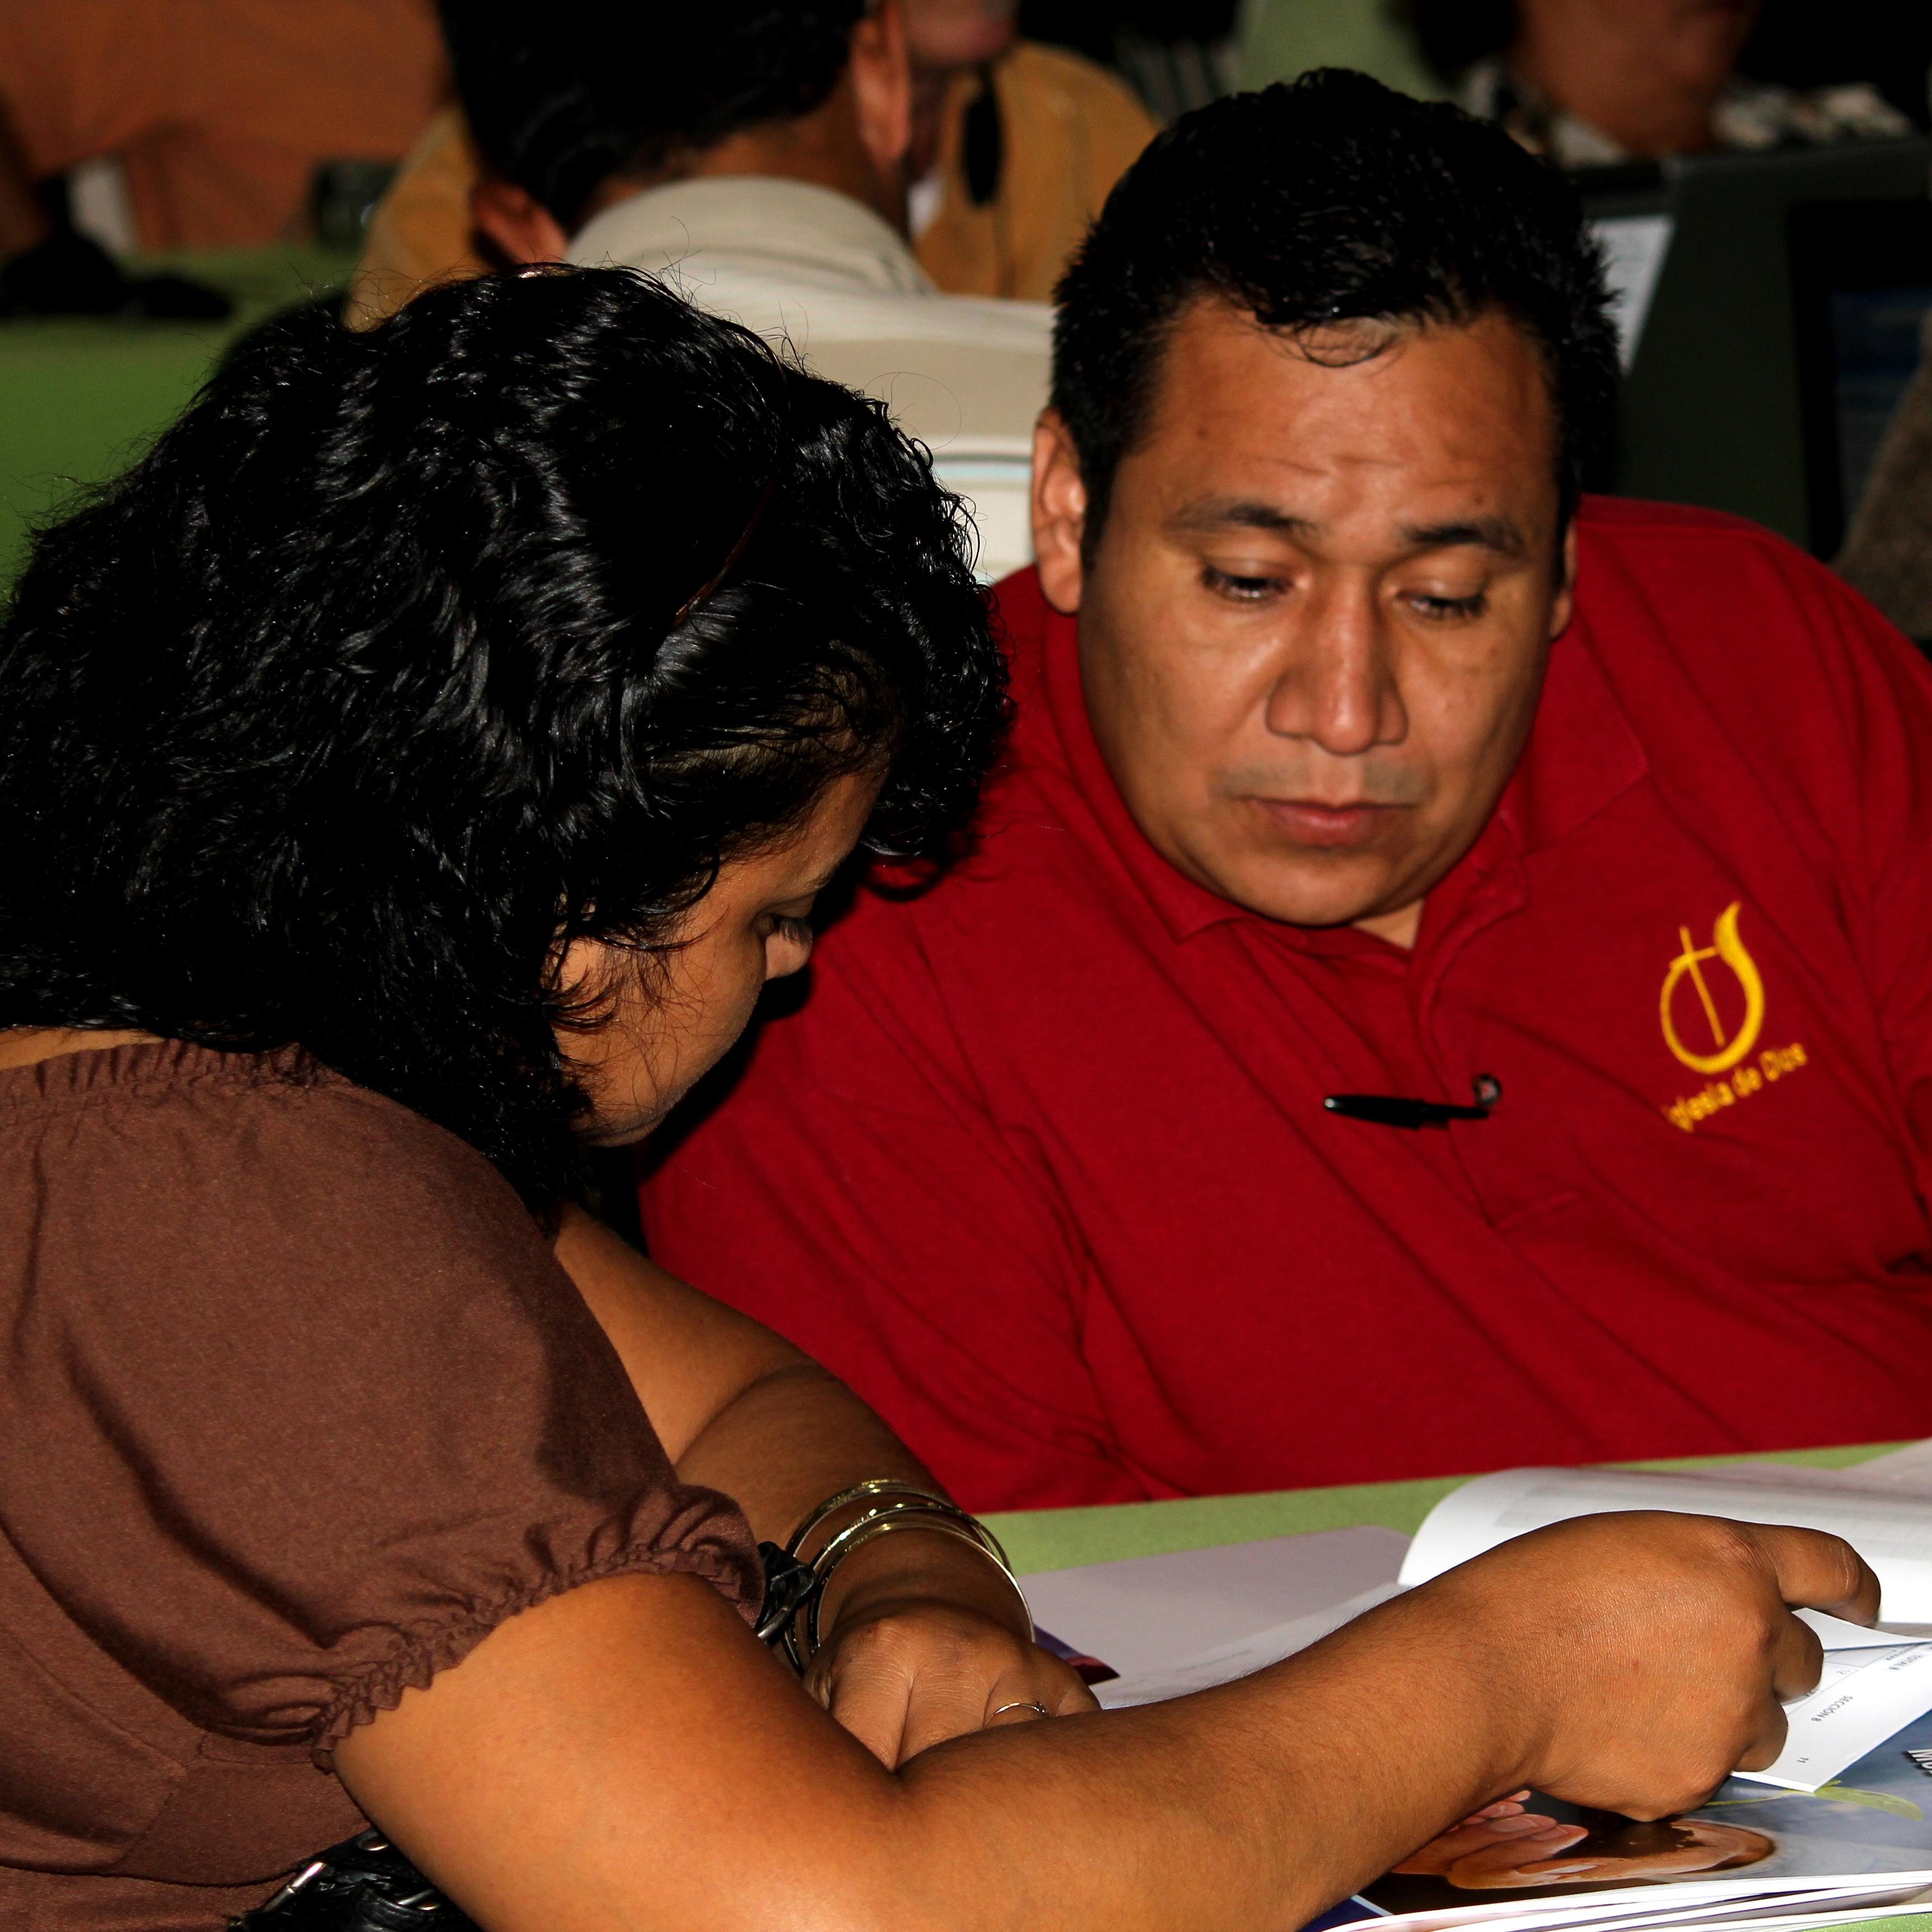
As a mentee (related to skills)
Listen assertively
Complete assignments
Do research
Be self-directed
Take advantage of your mentor’s gifts

