Slide 1


Slide 2


Slide 3

STEP 1: DOING RESEARCH
What do we want to know?
  Ethnicity and race
  Age
  Occupation
  Employment, unemployment, underemployment rates
View towards organized religion
Political affiliation
Marital status
Violence levels in the community

Slide 4
Why is this information important?
Helps the planter to…
determine the shape of the ministry
understand the history of the community
determine the type of worship experience to design
know what style of preaching to use
Notes:
Helps the planter to determine the shape of the ministry
Helps him to understand the history of the community
Helps him to determine the type of worship experience to design
Helps the church planter to know what style of preaching to use

Slide 5
How do we do demographics?
Notes:
(Exercise to do on a blackboard, whiteboard, or on newsprint)

Slide 6
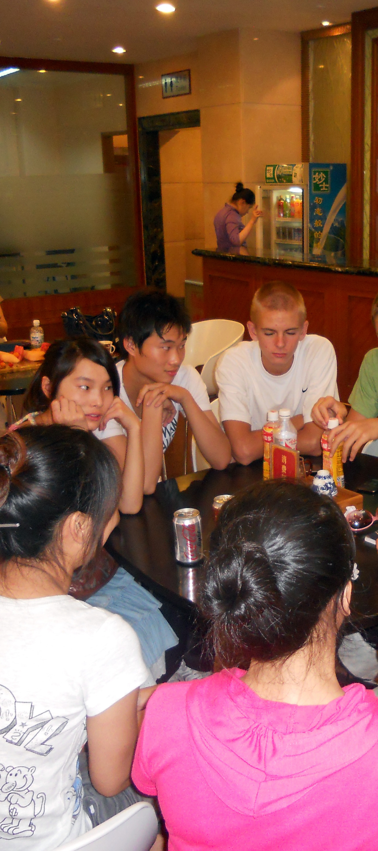
STEP #2: DOING EVANGELSIM
Definitions of evangelism
Evangelism as a lifestyle
Connecting
1) Naturally
2) Where people are
3) “Third-space” opportunities
4) Bridge ministries
What we need to know

Slide 7
Bringing people to commitment
Changes that need to take place
  Change of power
  Change of belief
  Change of will
Follow-up

Slide 8
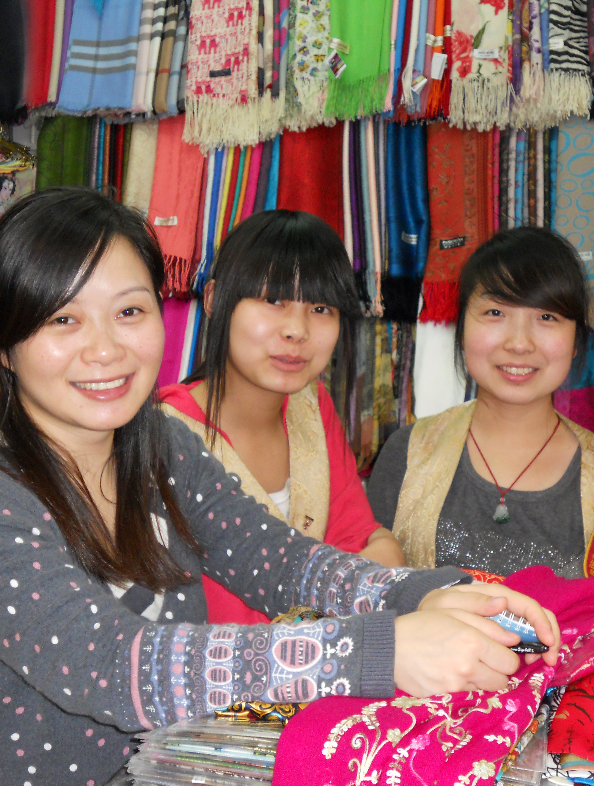
STEP 3: FORMING SMALL GROUPS
What is a small group?
Ground rules for a small group
The teacher in a small group
Questions to ask in a small group
Questions to avoid
Questions for clarification
Questions to involve everyone
Questions that deal with content
Questions for application

Slide 9
Inductive Bible Study
Different approaches to Bible study
1) Topical approach
2) Verse-by-verse approach
3) Redemptive history approach

Slide 10
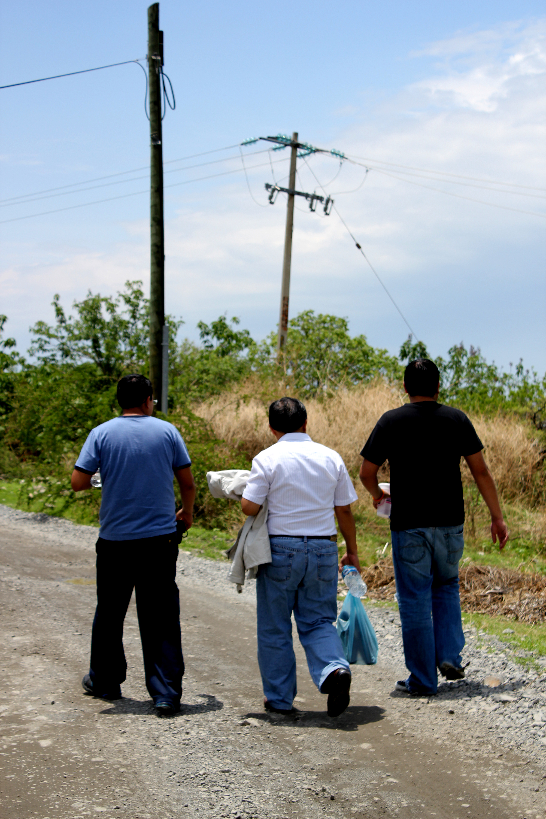
STEP 4: MAKING DISCIPLES
Definition of disciple
Ways in which a disciple becomes more Christ-like
  Conduct/behavior
  Thinking
  Character
  Commitment

Slide 11
Jesus the Master Teacher
Teacher
Rabbi
Prophet
Sage

Slide 12
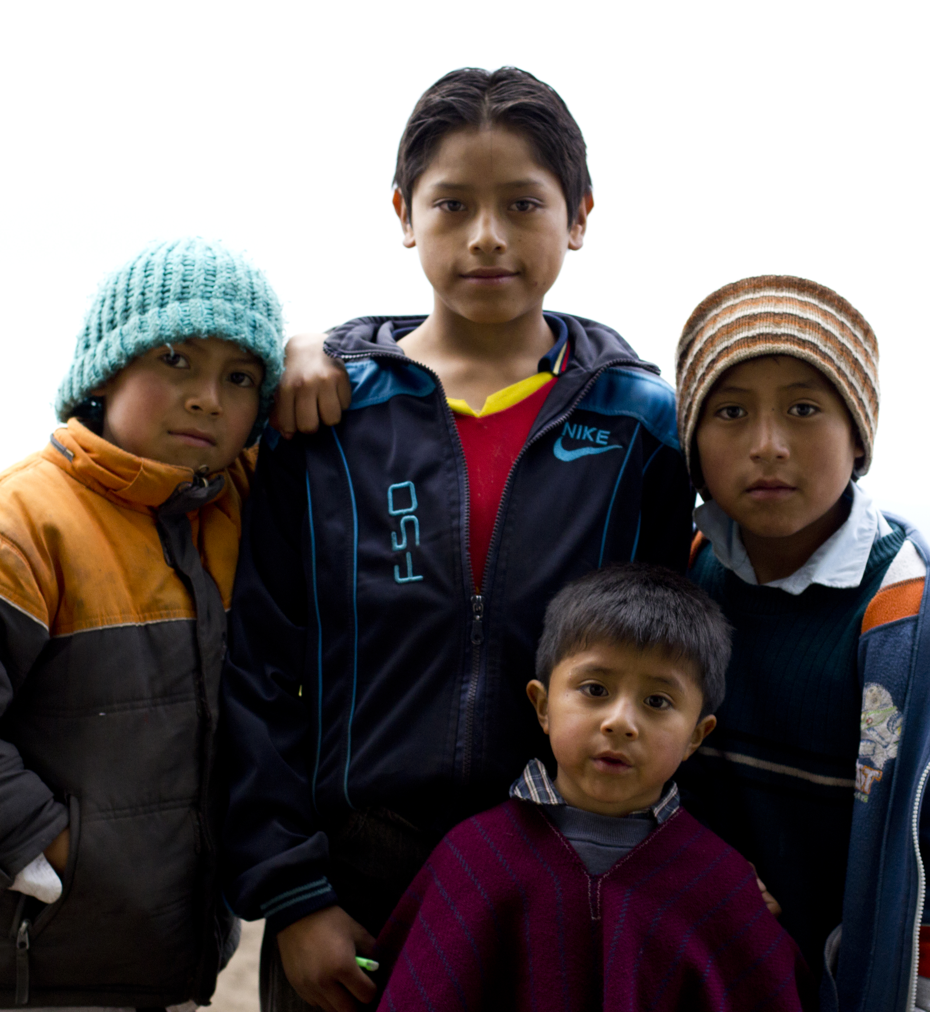
Contextualization
For culture
For ages
  Children
  Teens
  Adults

Slide 13
Learning styles
Imaginative learner
Analytic learner
Common sense learner
Dynamic learner

Slide 14
Methods of teaching
Small groups and home Bible studies
Sunday school
Children’s church
Christian camps
Adult Bible studies
Classes for singles or other specific groups

Slide 15
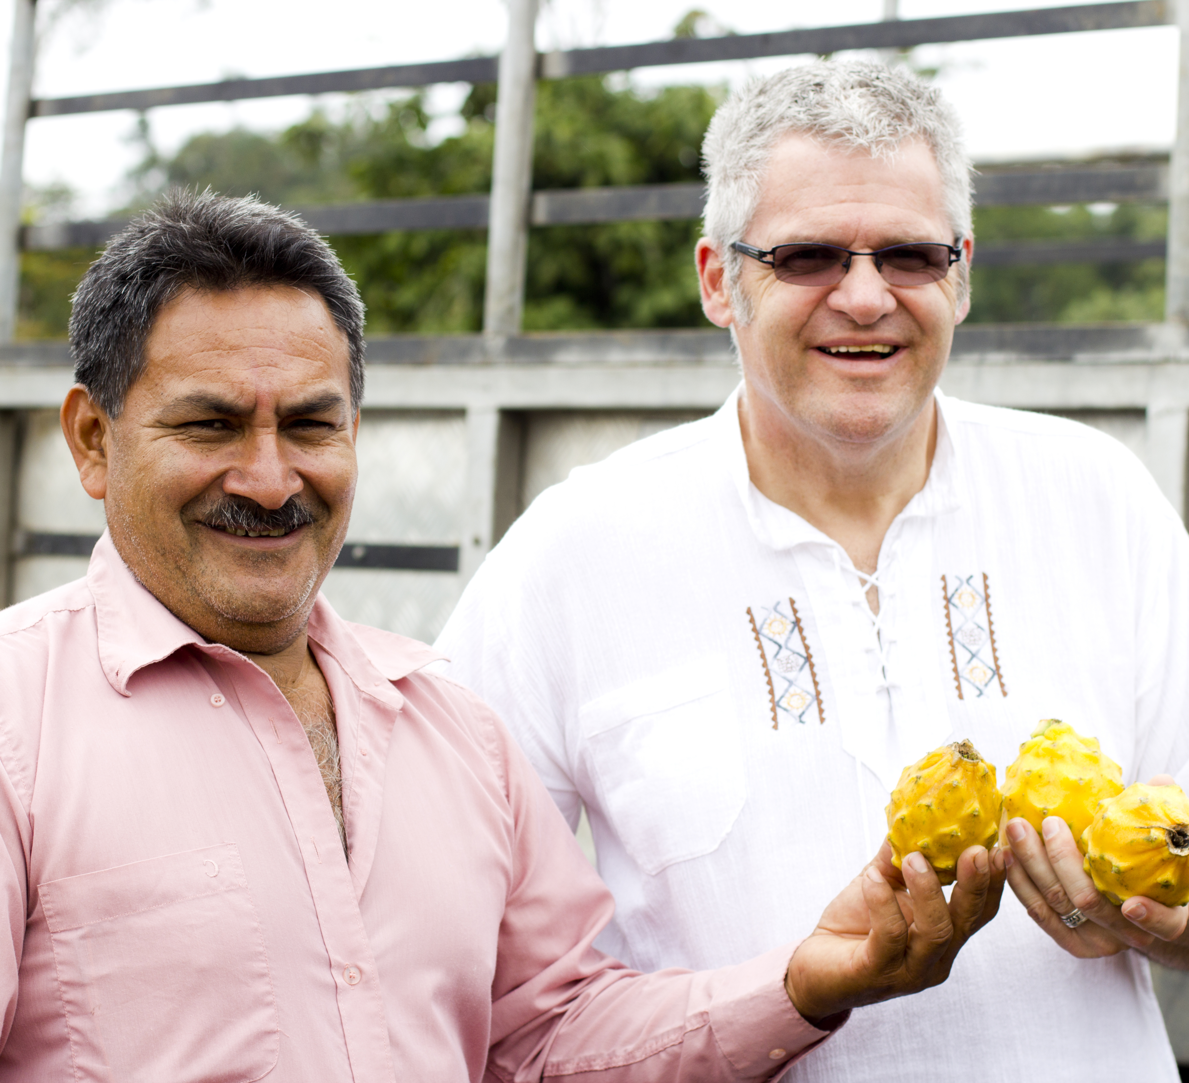
STEP #5:
MAKING LEADERS
STEP #6:
REPRODUCING AND MULTIPLYING LEADERS

