Slide 1


Slide 2


Slide 3

Models of Church Planting
To be presented:
I. Individual models
II. Mother-daughter models
III. Models involving several churches

Slide 4
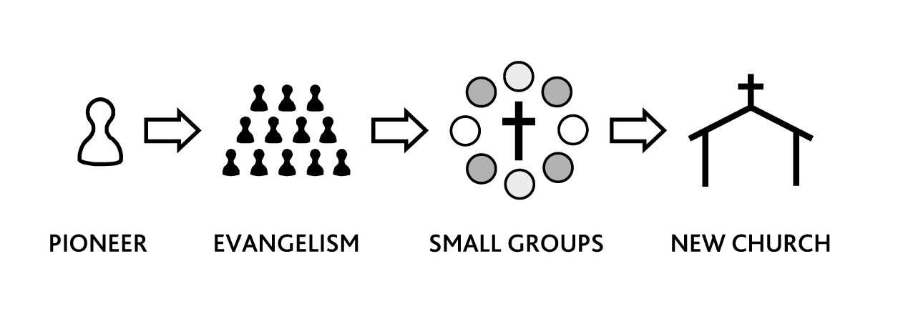
I. Individual Models
Pioneer
  Advantages
  Weaknesses

Slide 5
Pioneer, continued
Founding pastor
  Advantages
  Weaknesses
Bi-vocational pastor
  Advantages
  Weaknesses

Slide 6
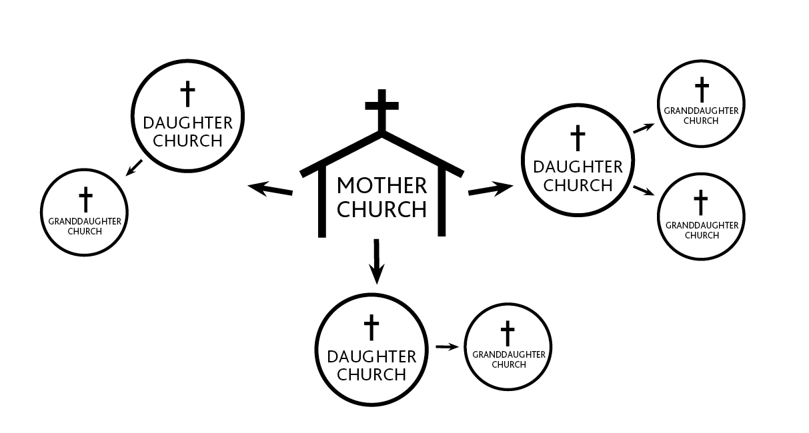
II. Mother-Daughter Models
A. Daughter church
  Advantages
  Weaknesses

Slide 7
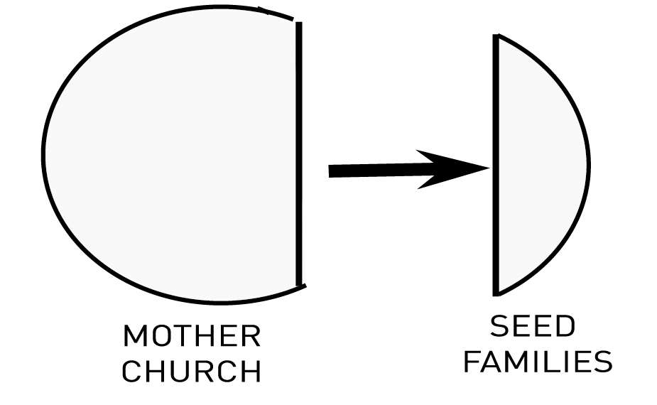
II. Mother-Daughter Models
B. Colonization

Slide 8
II. Mother-Daughter Models
C. Adoption
  Advantages
  Weaknesses

Slide 9
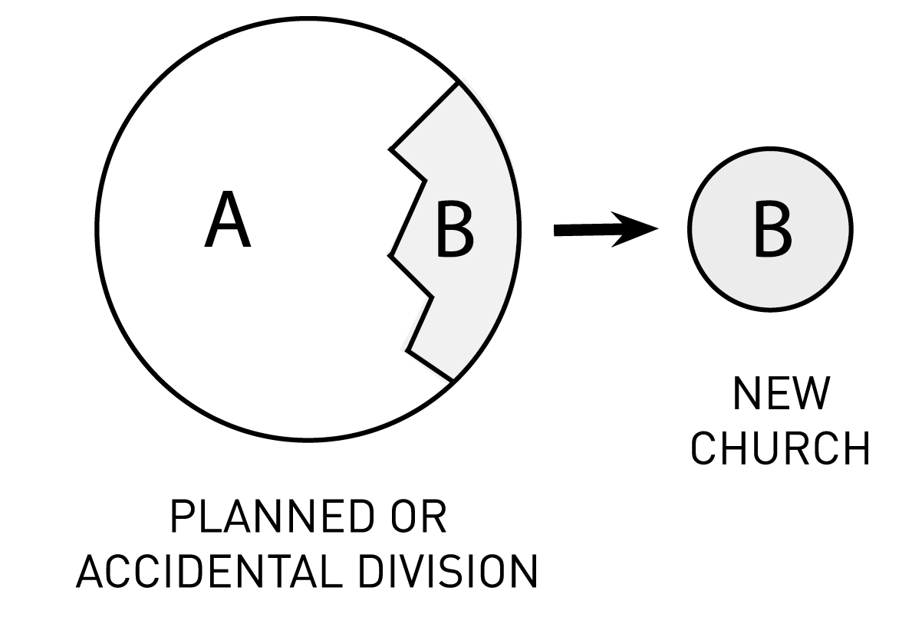
D. Accidental Parenthood

Slide 10
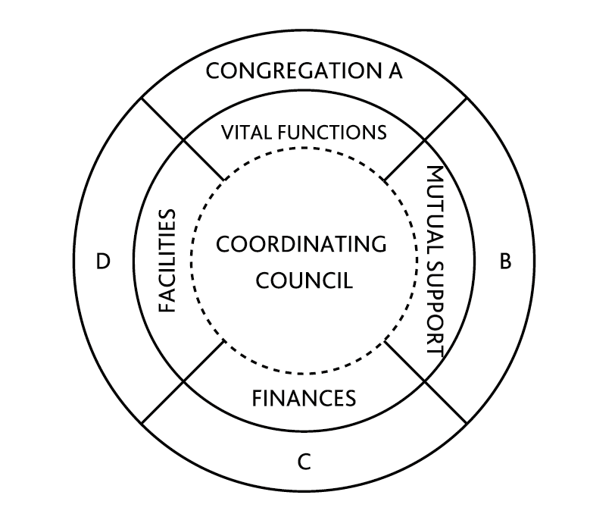
E. Multi-congregational
  Advantages of this model

Slide 11
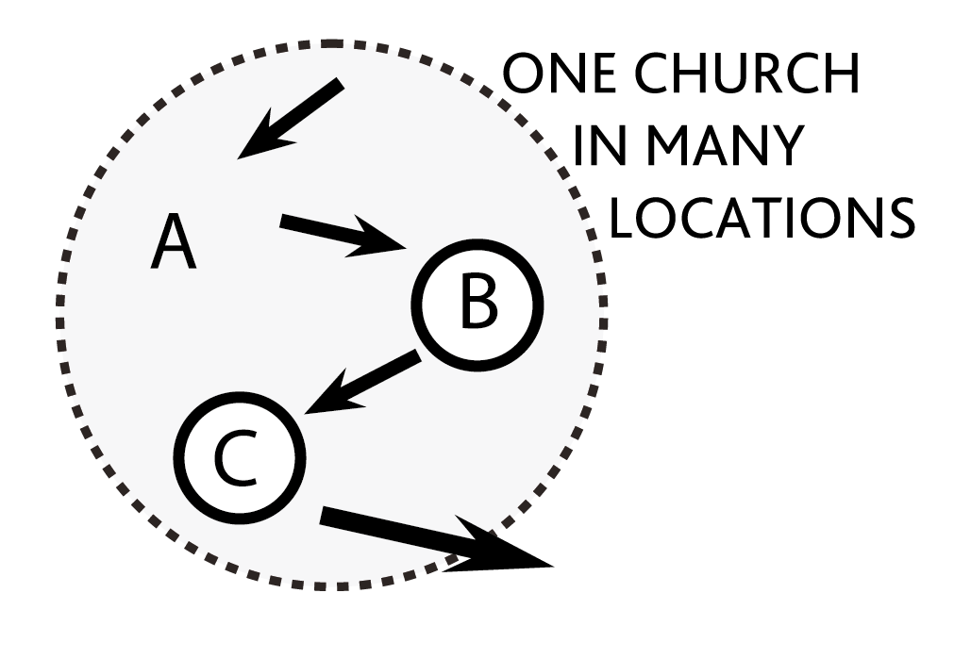
F. Multi-campus

Slide 12
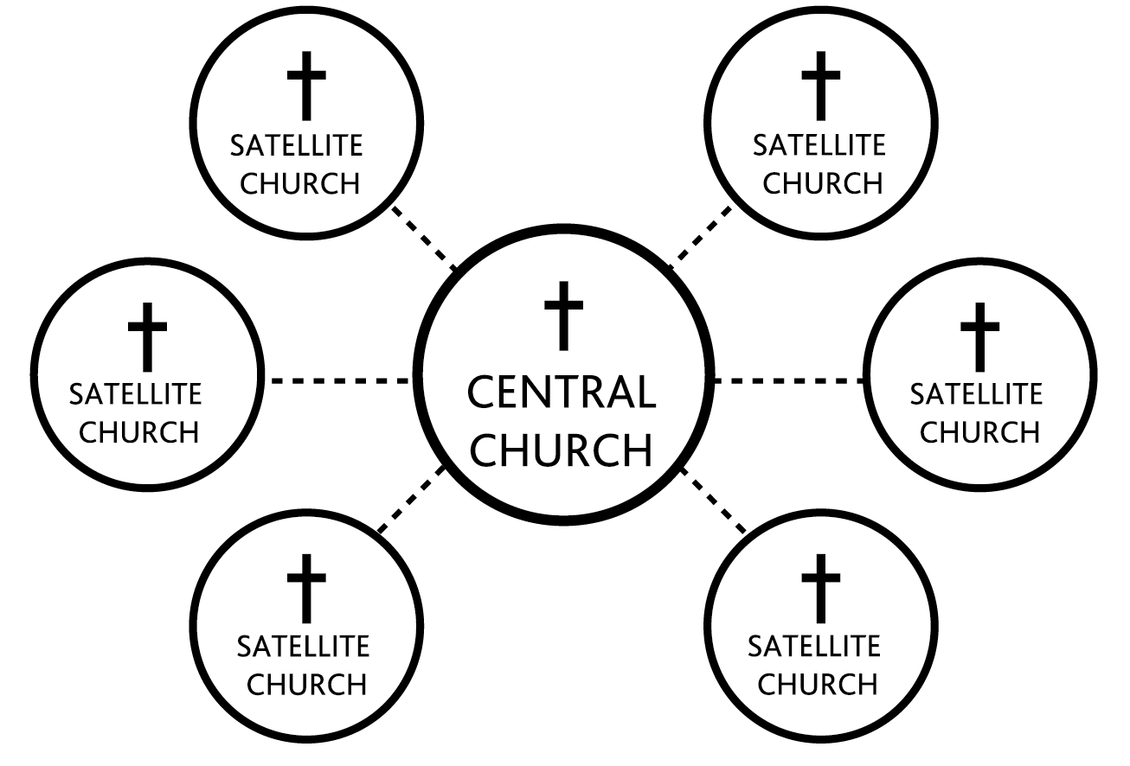
G. Satellite

Slide 13
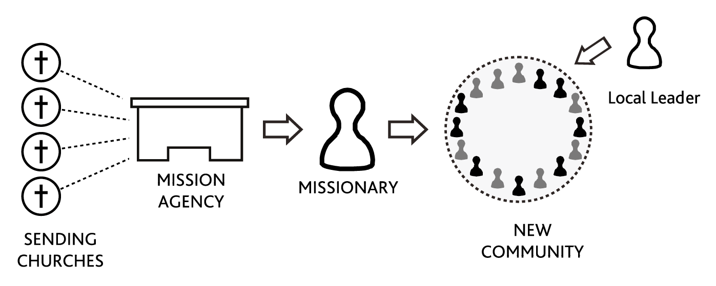
III. Models involving Several Churches
A. Missionary church planting
  Advantages
  Weaknesses

Slide 14
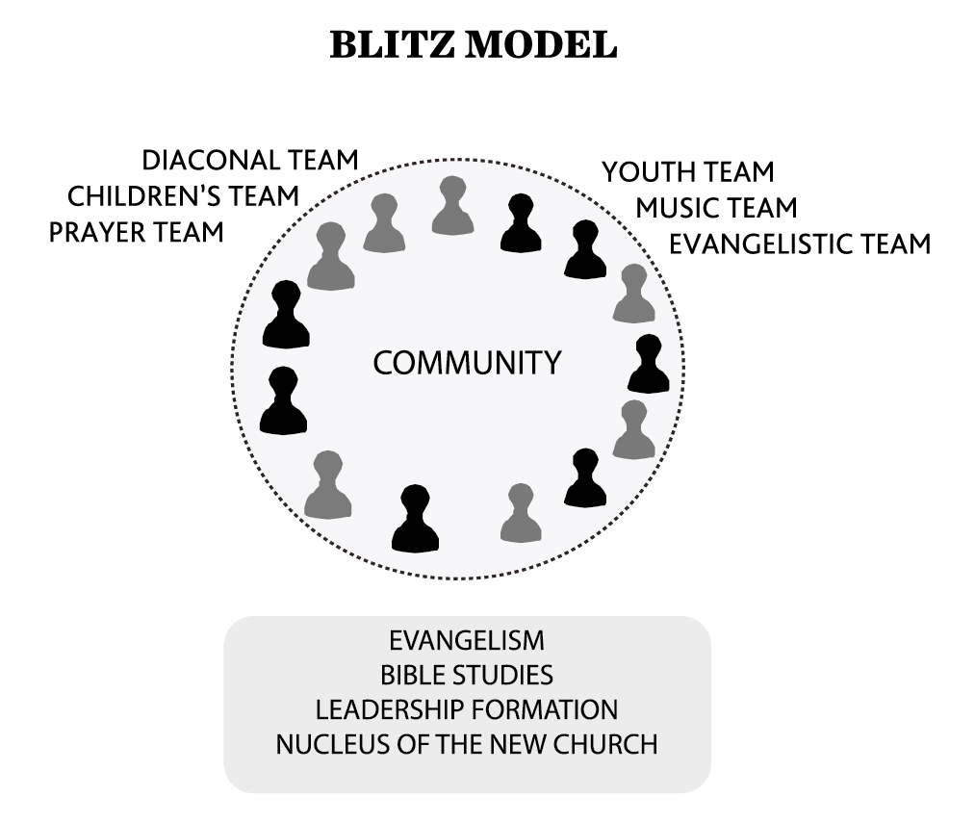
III. Models involving Several Churches
B. Missionary Teams
  Advantages
  Weaknesses

Slide 15
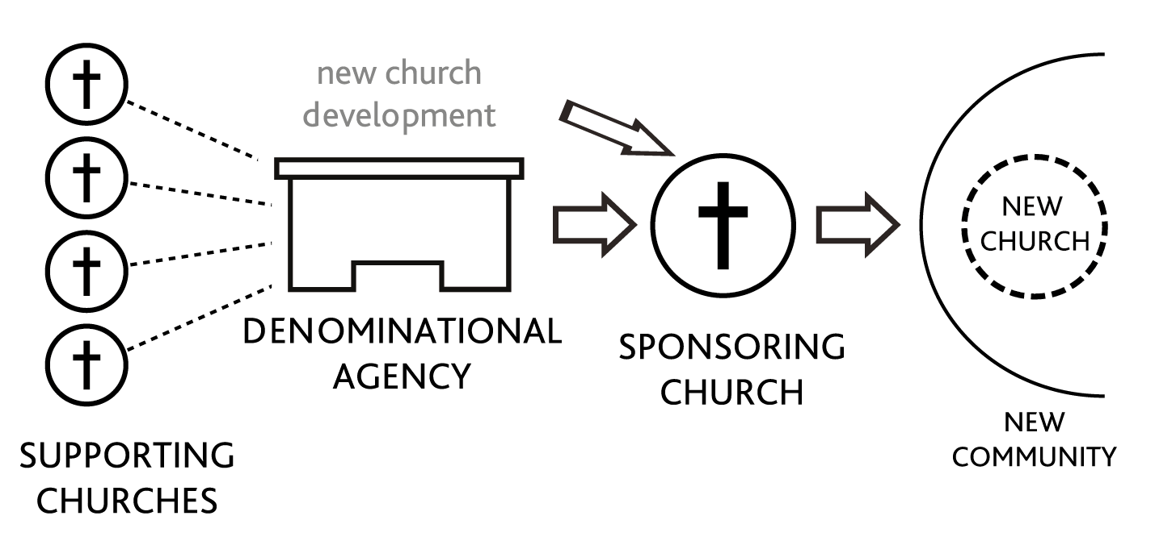
III. Models involving Several Churches
C. Church-Mission Agency Partnership
  Advantages & Weaknesses
D. Associational or denominational CP
  Advantages & Weaknesses

Slide 16
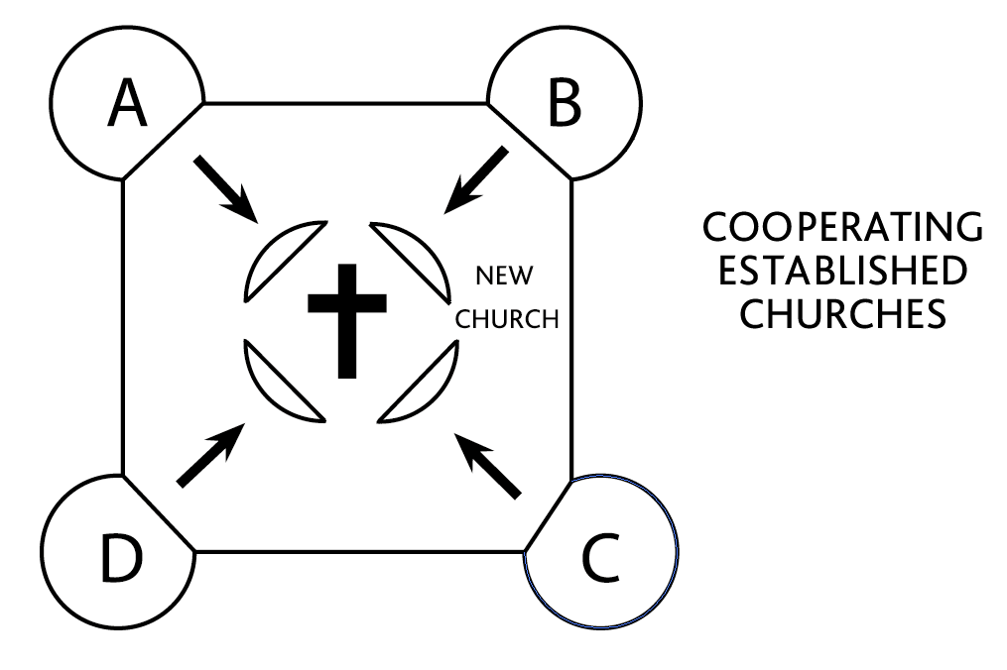
III. Models involving Several Churches
E. Regional

Slide 17
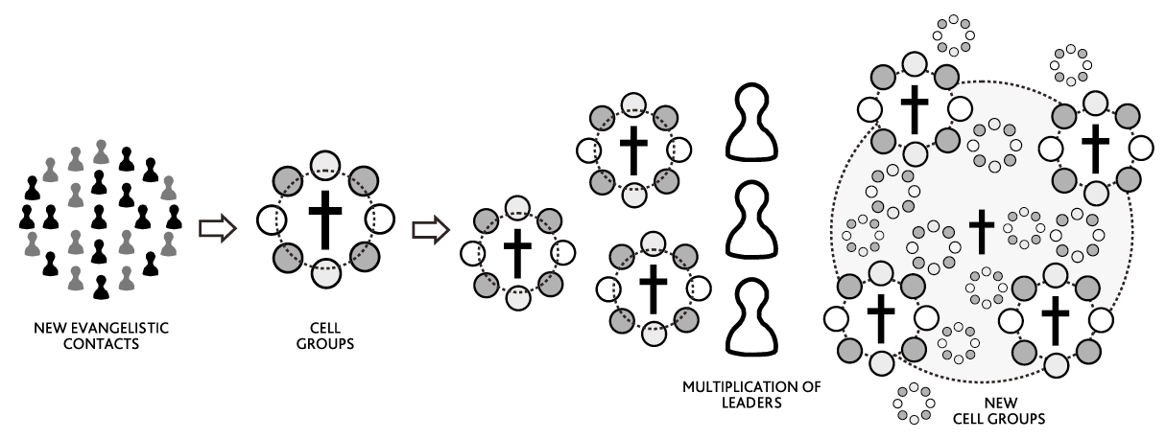
IV. Other Models of CP
Cellular

Slide 18
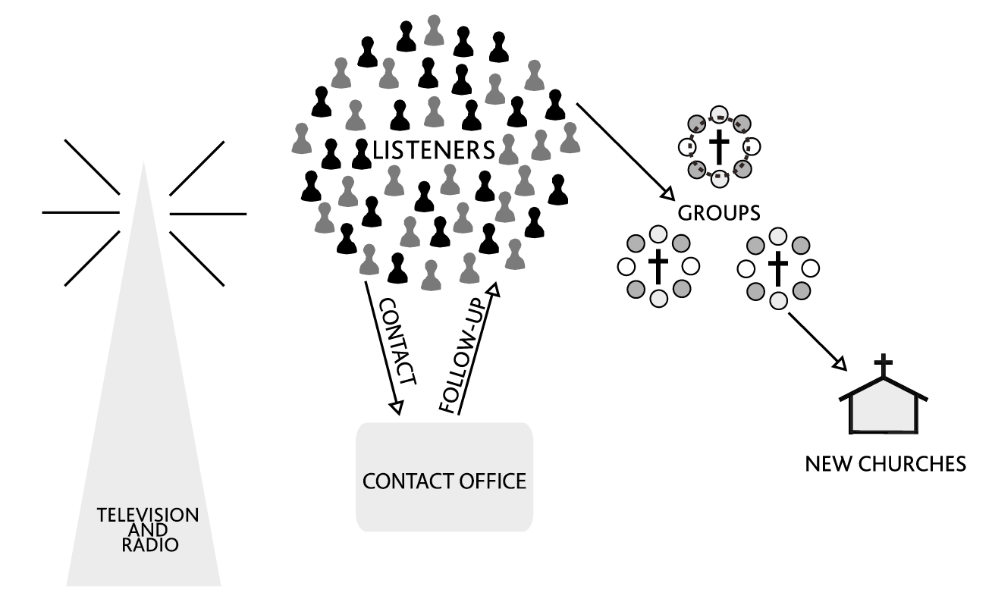
IV. Other Models of CP
B. Mass Communication

Slide 19
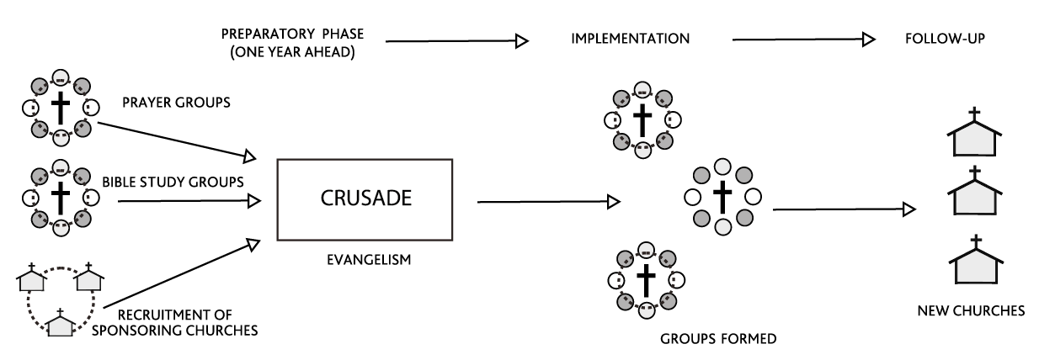
IV. Other Models of CP
C. Crusade

Slide 20
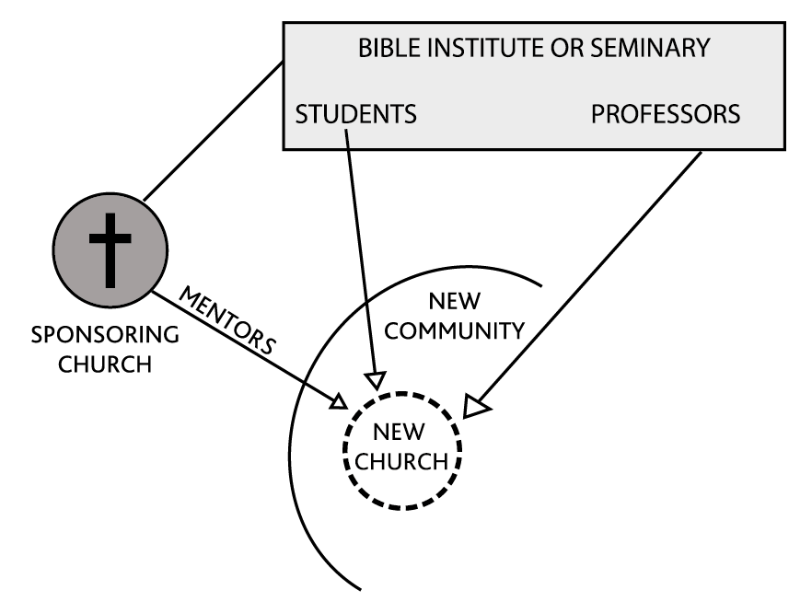
IV. Other Models of CP
D. Seminarian

Slide 21
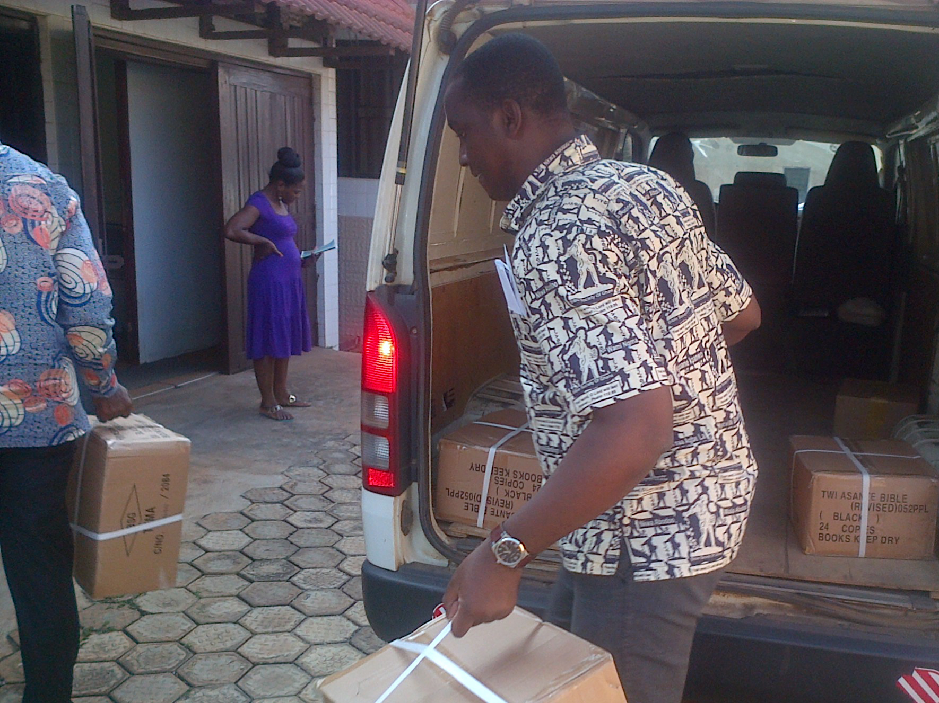
E. Diaconal Model

Slide 22
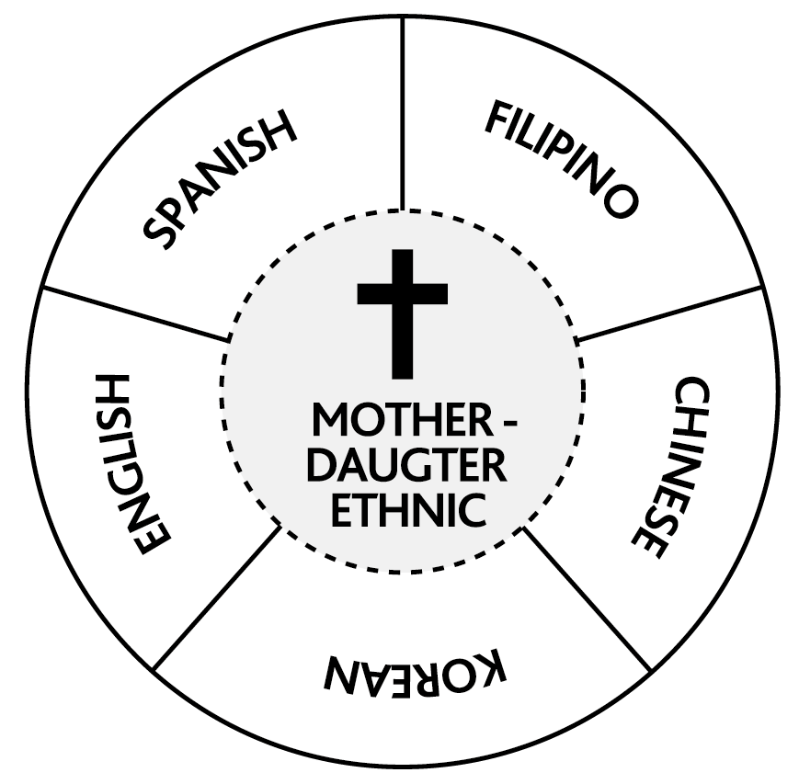
V. Models for Multiethnic Contexts
A. Mother-daughter

Slide 23
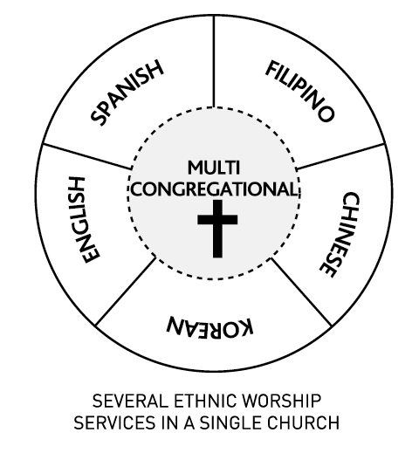
V. Models for Multiethnic Contexts
B. Multi-congregational

Slide 24
V. Models for Multiethnic Contexts
D. Multiple Sponsorship
E. House church model
F. Multi-lingual satellite

Slide 25
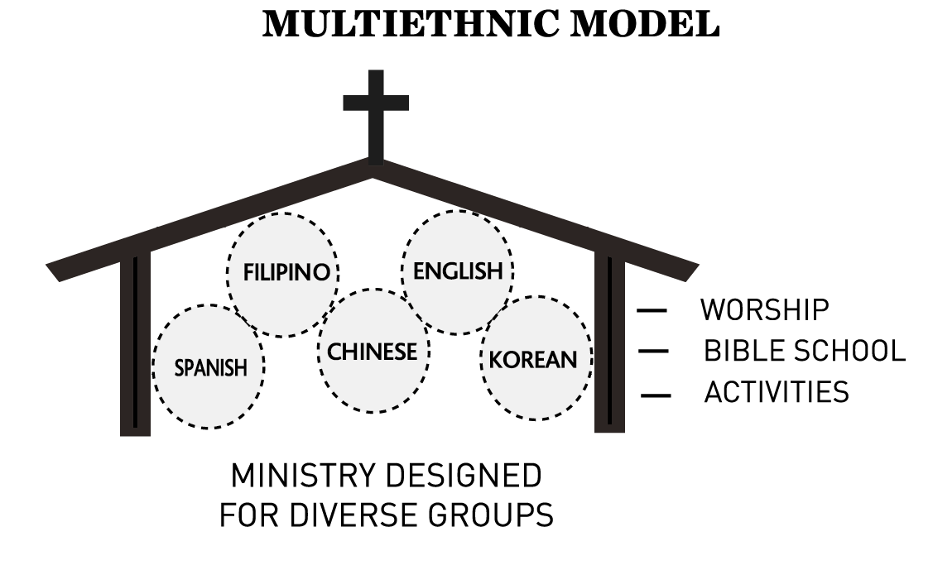
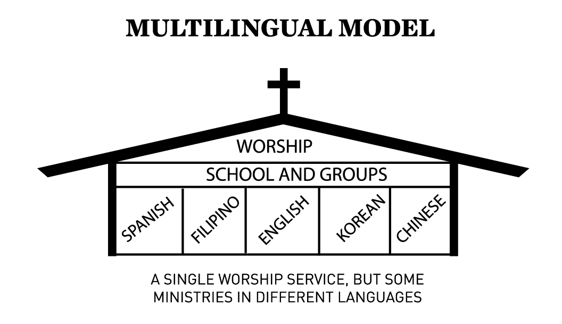
Multi-ethnic & Multi-lingual

Slide 26
Selecting a Model
Select a model that…
Enables you to best reach your immediate ministry goals
Enables you to fulfill your long-range vision
Best fits your particular targeted people group... is as comprehensive and yet workable as possible
Will be effective in your social context

